Slide 1


road water management for Resilience hgaliwango@metameta.nl

Slide 2
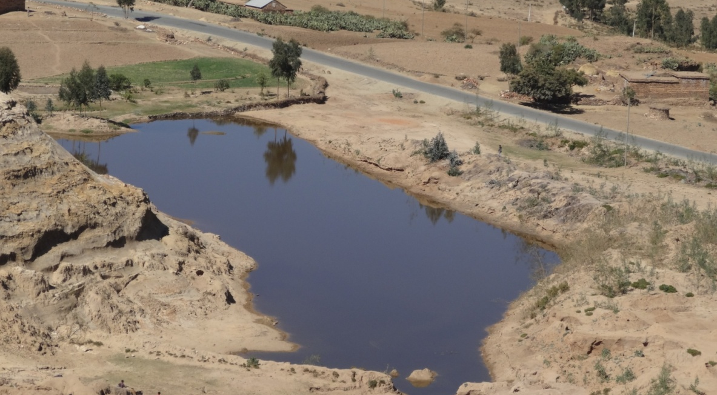
Dream and opportunity
- To have roads systematically used
- for water recharge/retention, storage
- and water management all over the world,
- especially in Sub Saharan Africa and Asia
- and create win-wins

Slide 3
Because
Annual investment 1-2 Trillion USD
40% in developing countries
1 Billion people totally unconnected
Increased water stress – most poor in water stressed areas (74%)
United Nations Secretary-General’s High-Level Advisory Group on Sustainable Transport:
‘Transport plays an essential role in countries’ economic growth, competitevness, balanced and liveable spatial development, access to water and energy and food saving’

Slide 4
Because....
Annual increase of roads: f.i. 70,000 km in SSA
Water is 35% of damage to paved roads, up to 80% to unpaved roads
Roads change the surface hydrology and have major impacts on run-off
  now often causing local flooding, water logging and erosion
  This can be turned around in large potential for water harvesting and water management

Slide 5
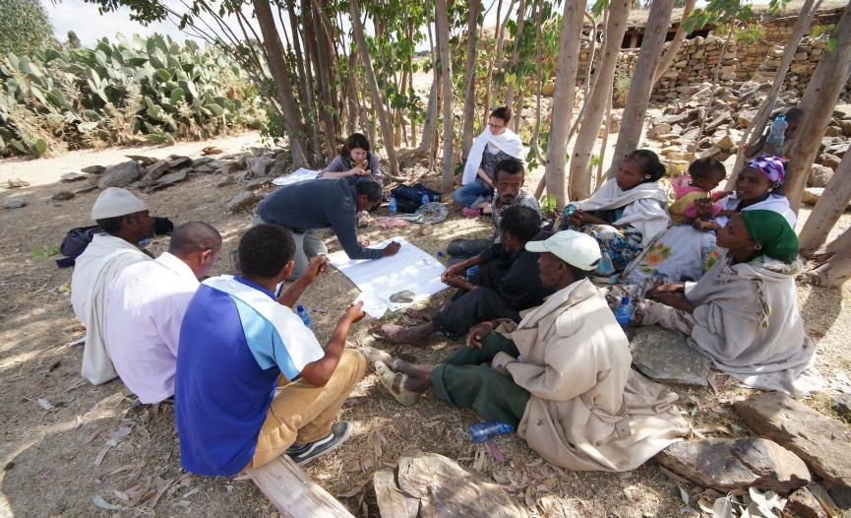
Some results of reconnaissance studies
In 200 kilometers:
  Erosion and sedimentation: 150 locations
  Flooding of houses and land: 45 locations
  Persistent waterlogging: 65 location
Deficiencies in governance process
  Missing from guidelines
  No coordination
  No interaction with road-side communities
Social impacts
  Damage to land and houses, dust
  Poor – most vulnerable least access to potential
  No compensation, indirect litigation

Slide 6
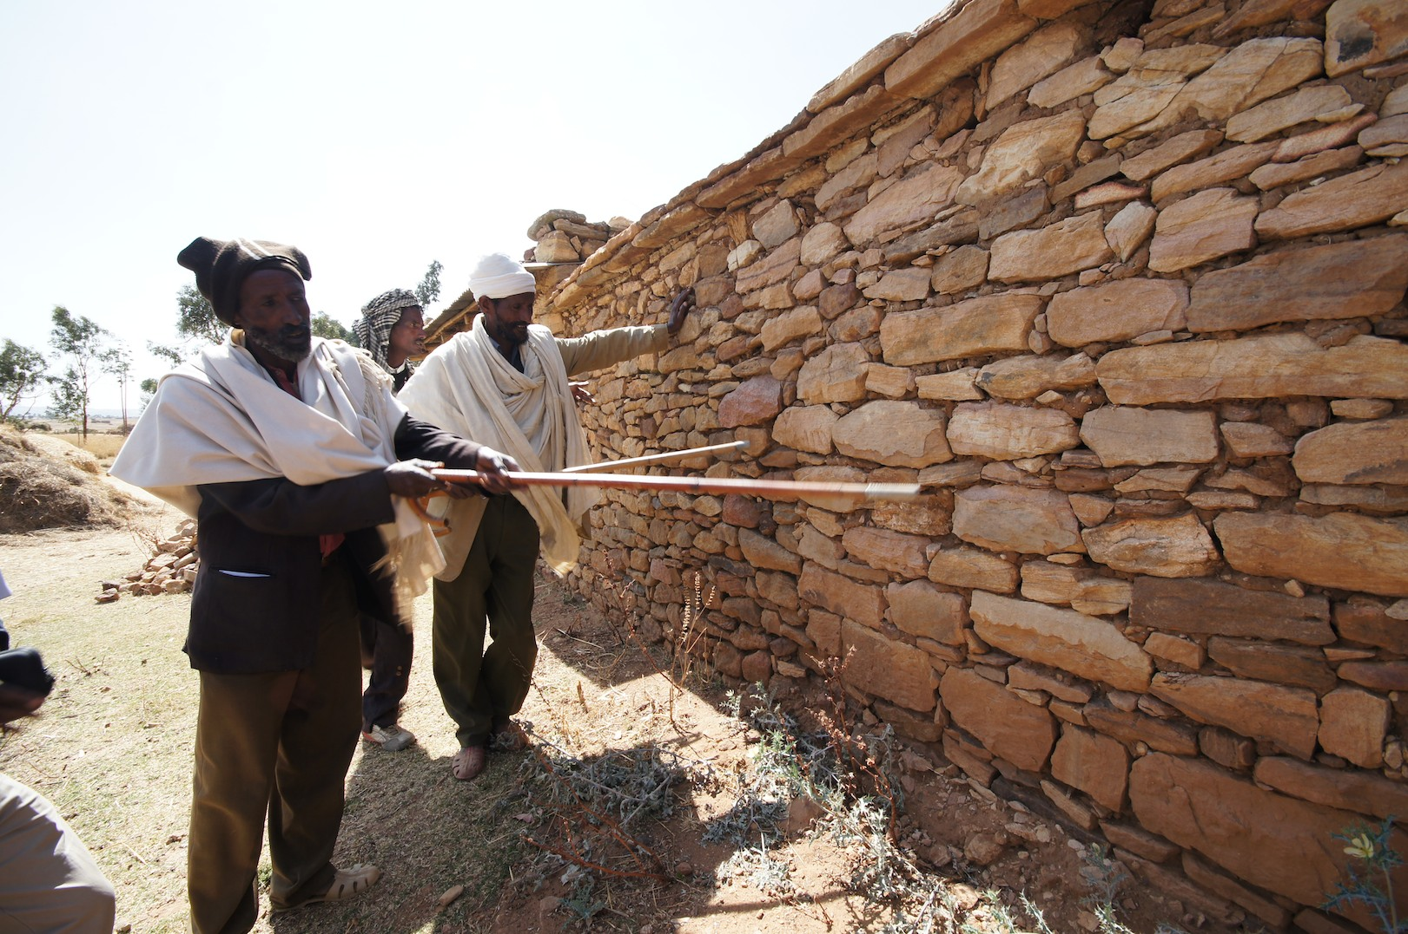
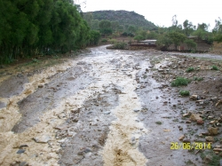
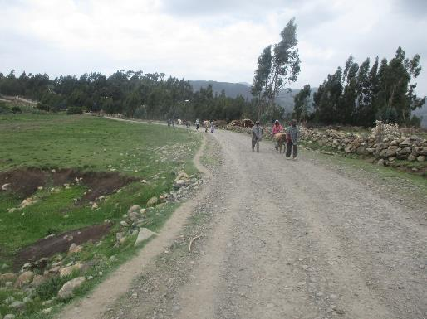
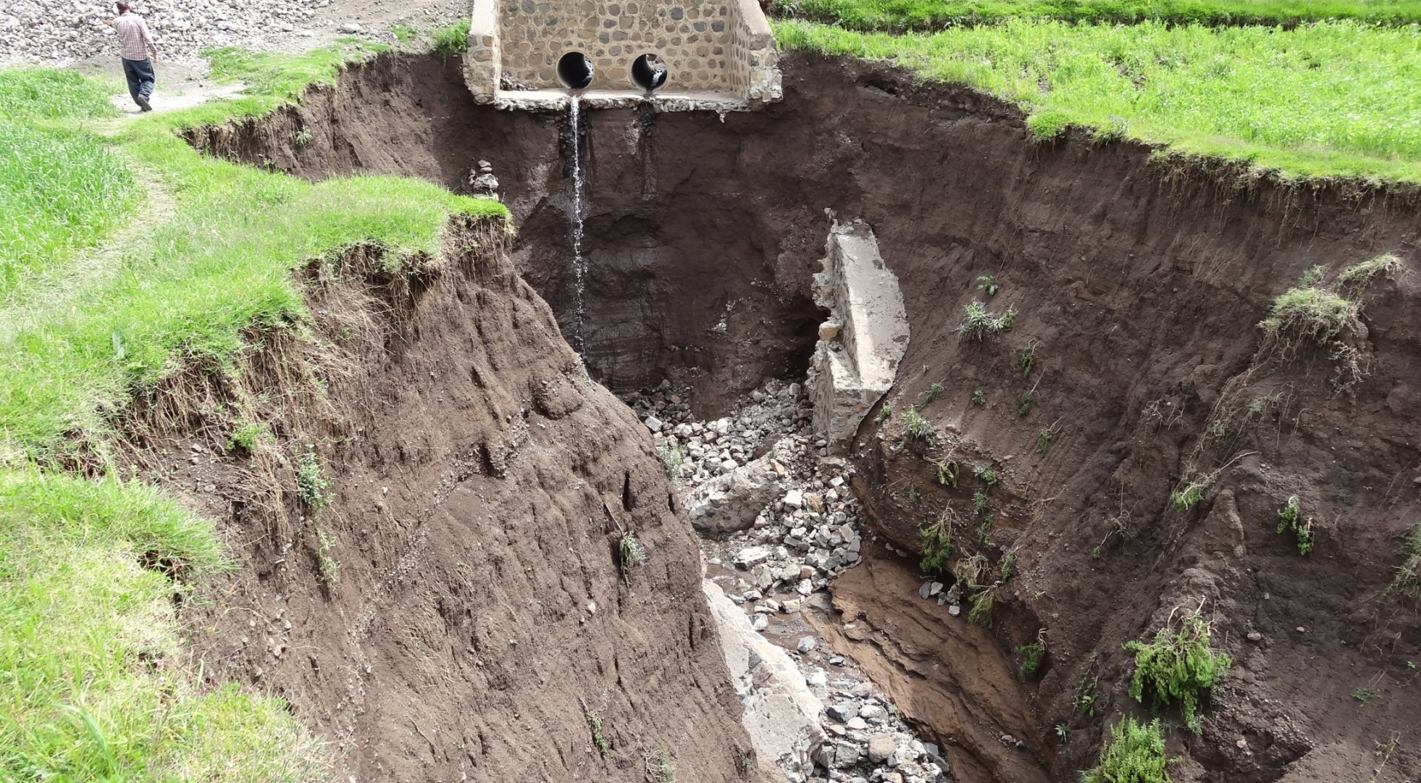
Urgent need to turn things around
Floods
Esp feeder roads damaged
Sedimentation
Erosion

Slide 7
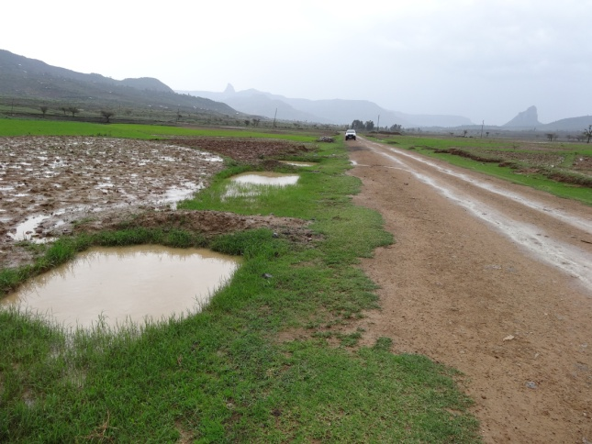
Triple Win
REDUCED WATER
DAMAGE
TO ROADS
(-35%, -80%)
And more reliable
Roads
WATER MANAGED
FOR PRODUCTIVE USE
Rising groundwater levels and better soil moisture
Water retention
Erosion control
Flood management
REDUCED
DAMAGE FROM ROADS
Through Flooding,
Erosion and Sediment
Deposition

Slide 8
The impact of resilient roads
 | Resilience | Impact
1 | Reduced damage in the wake of disaster and unusual events | Reduced cost of road maintenance
 |  | Reduced damage due to erosion
 |  | Reduced damage due to flooding
 |  | Reduced damage due to sedimentation
2 | Unlocking the economic potential | Less down time of roads
3 | Co-benefits | Beneficial use of water harvested from roads

Slide 9
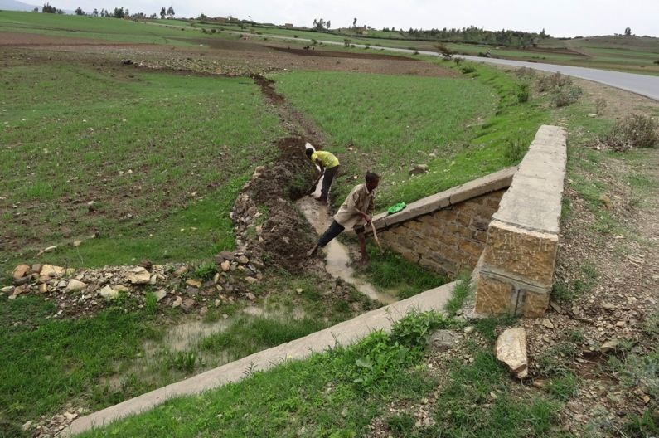
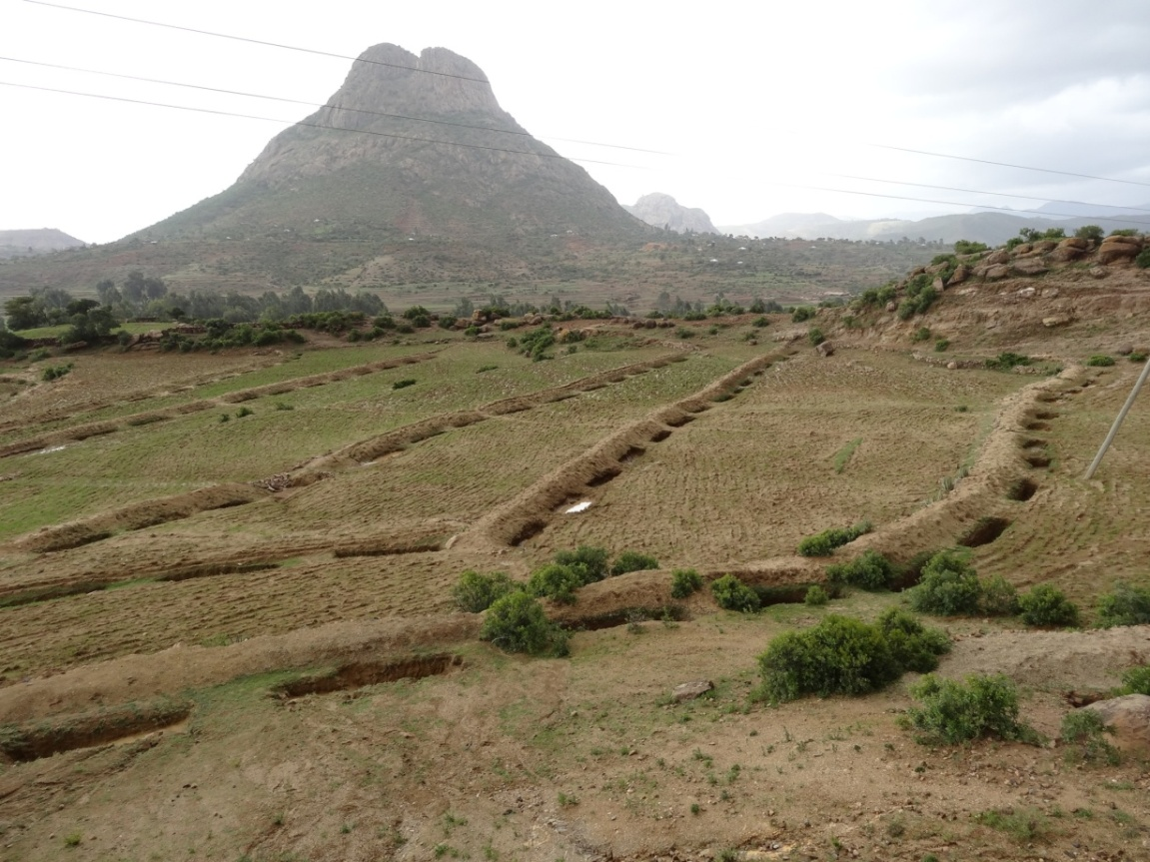
Turning things around: Harvesting water from roads in Ethiopia – example of impact
Capturing rainfall for dry period as groundwater, soil moisture or surface water
Implemented since 2014
Withstanding 2015 El Nino
Engaged> 2.75 M people in 2015/7 campaigns
Benefitted 2.4 M people
Guidelines
Outscaling now to Bangladesh, Kenya, Uganda, Malawi, Mozambique, Tajikistan, Zambia, Nepal, Bolivia

Slide 10
Three Approaches
Making use of the road as it is for water management
Modifying design of the road
Additional measures & opportunities

Slide 11
Different techniques
Adapting to changed road run-off
  Spreading water from road surface
  Harvesting water from culverts, side drains and depressions
      Converted borrow pits
      Infiltration ponds
      Infiltration trenches/ pits
      Swallows
      Diversions/cutoffs/trenches to farm
  Gully plugging for recharge
  Spring capture

Slide 12
 | Road water management technique | Surface storage | Soil moisture storage | Shallow groundwater recharge
1 | Flood water spreaders along road surfaces |  | ■
2 | Flood diversions from culverts and road drainage |  | ■ | ■
3 | Infliltration structures fed from road drainage |  |  | ■
4 | Cascading irrigation from road drainage
5 | Surface storage fed from road drainage (borrow pits, ponds and cisterns) | ■ |  | ■
6 | Road bodies used as dams | ■
7 | Road crossings used as sand dams or as water spreading structures |  | ■ | ■

Slide 13
Different techniques
Optimizing road design for multiple functions
  Irish bridges/drifts/low causeways
    Flood water spreading
    River bed stabilization
    Acting as sand dams
  Changing road alignment to recharge areas
  Optimize culvert location

Slide 14
Collecting water from a culvert

Slide 15
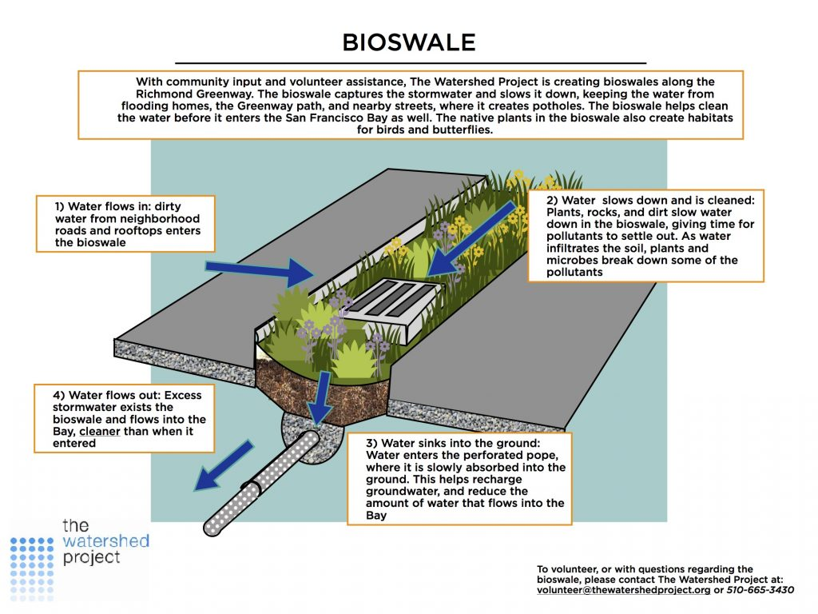

Slide 16
Water bars/rolling dips

Slide 17
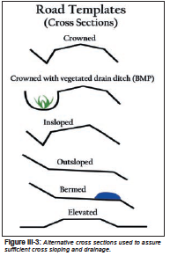

Slide 18
Non-vented drift/low causeway

Slide 19
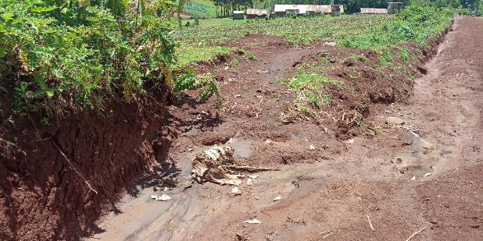
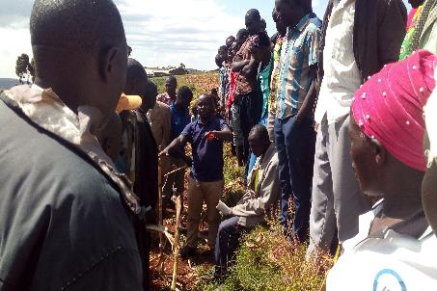
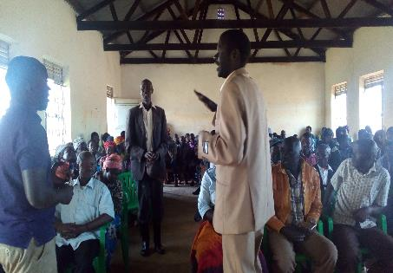
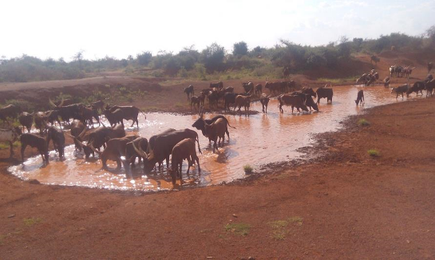
Uganda – IFDC
Uganda: managing rice field with roads
Training and demonstration to road side commuities
Mitre drain blocked by farmers
Kapchorwa: Borrow pit with potential of water harvesting can be turned into a storage pond
Community training

Slide 20
Examples from different countries

Slide 21
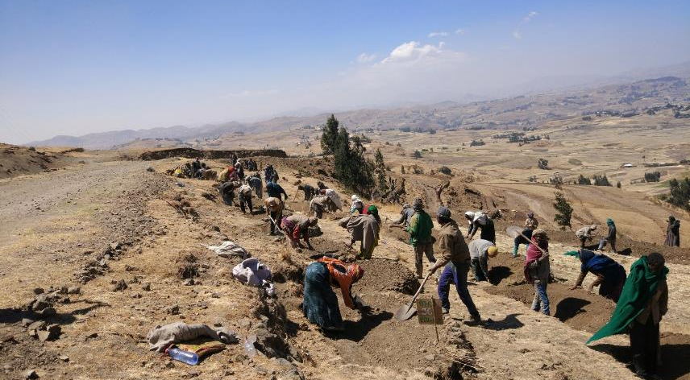
ETHIOPIA: ROAD WATER HARVESTING CAMPAIGN

Slide 22
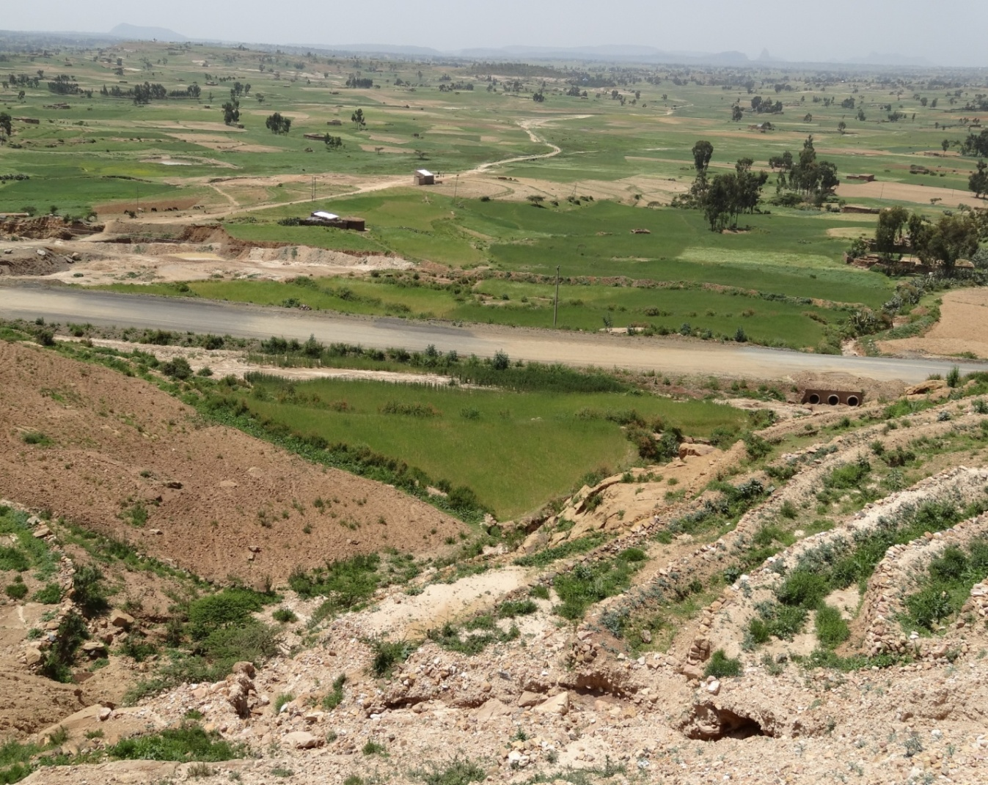
ETHIOPIA: CATCHMENT APPROACH
Borrow pit
Culverts
Deep trenches
Communities which used to have been affected by flooding are saved from flooding.

Slide 23
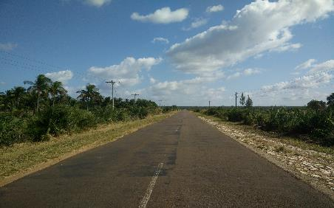
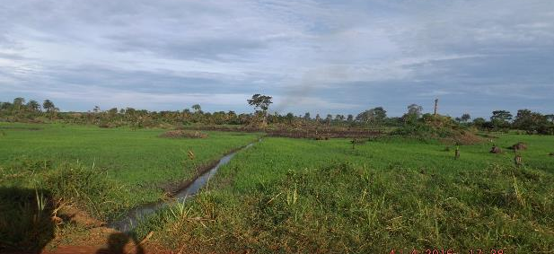
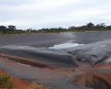
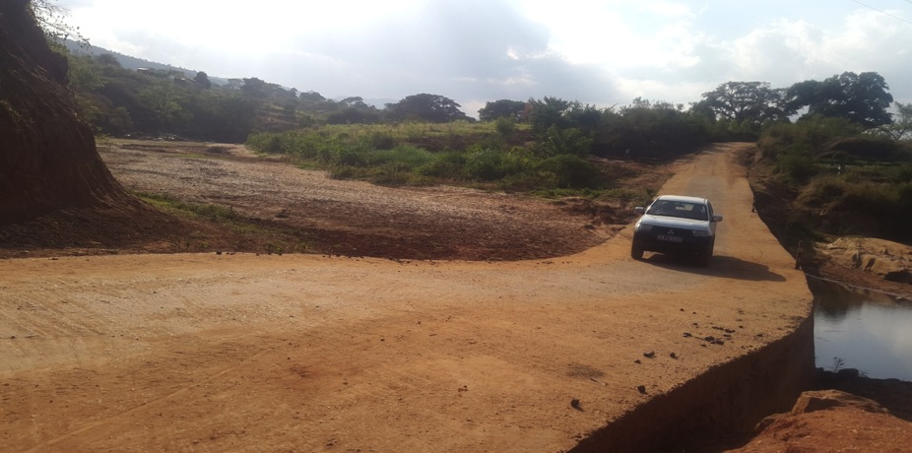
MANY COUNTRIES, CONTEXTS AND SOLUTIONS
Uganda: managing rice field with roads
Mozambique: low embankment
roads to manage wetlands
Uganda: managing rice cultivation with roads embankments and culvert
Zambia: Converting borrow pits
Kenya: Road drifts as sand dams

Slide 24
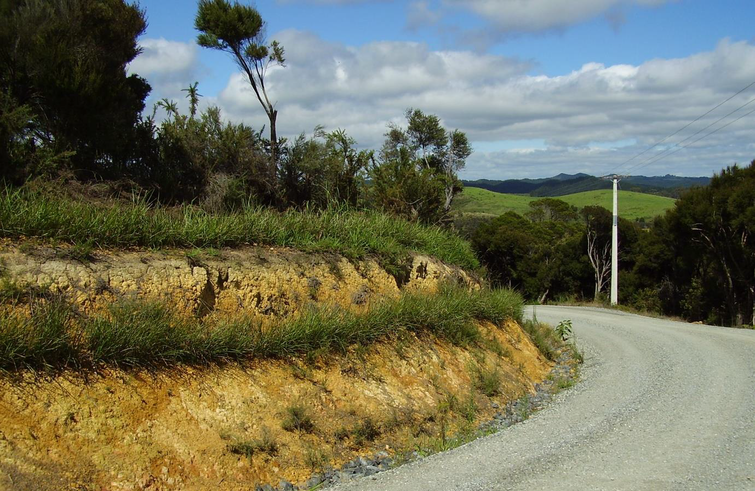
Vetiver stabilization (Bio Engineering) – Examples from Madagascar

Slide 25
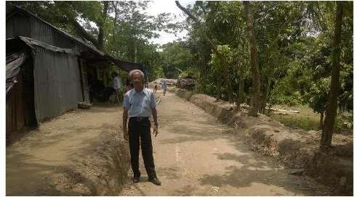
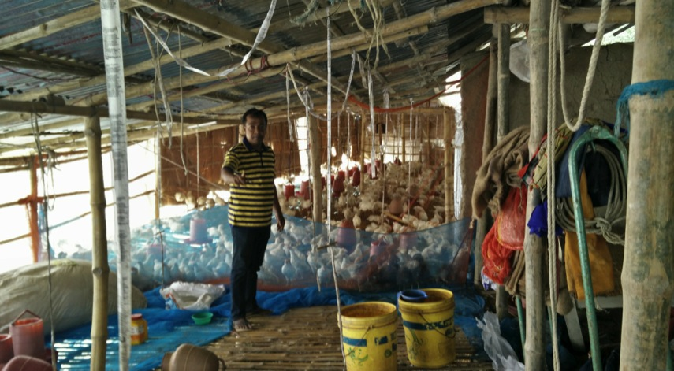
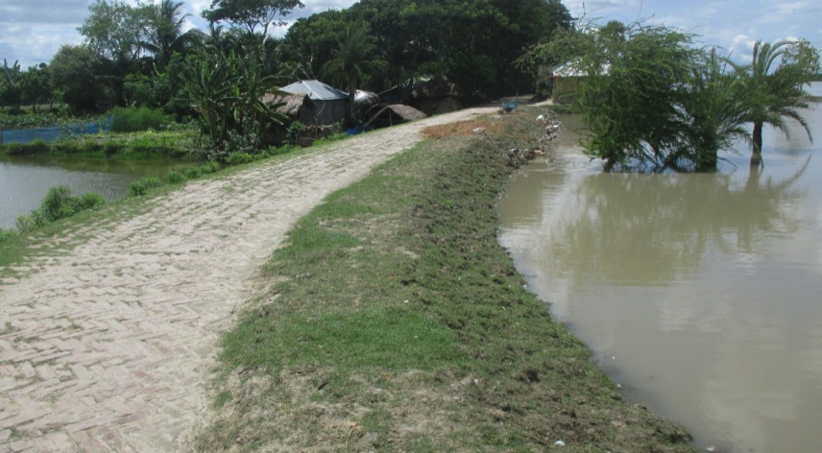
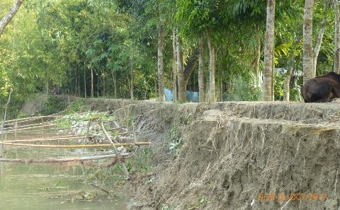
BANGLADESH: USING ROADS AS EFFECTIVE EMBANKMENTS
Synchronized levels
Flood shelters
Better protection
Roads as embankments

Slide 26
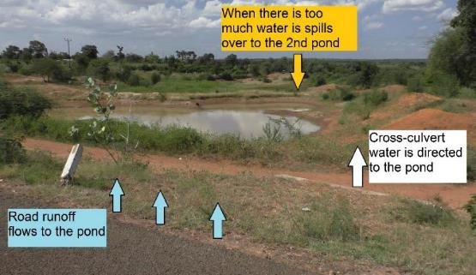
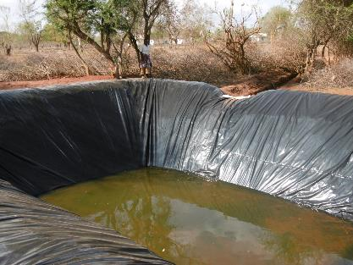
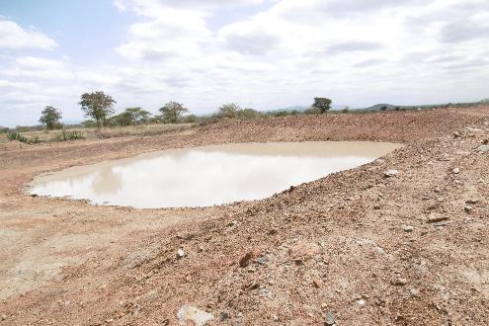
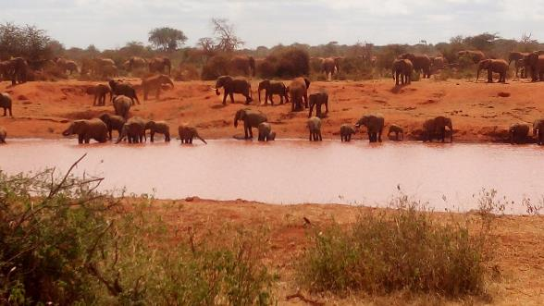
KENYA: ROAD RUNOFF COLLECTED IN STORAGE STRUCTURES
On farm pond collecting road runoff
Converted borrow-pit for water storage
Opportunity: Road water for wildlife

Slide 27
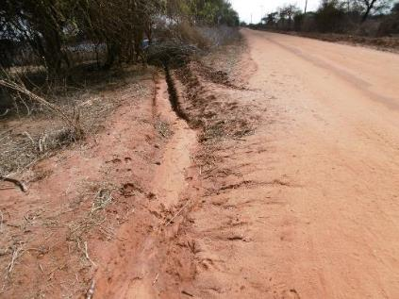
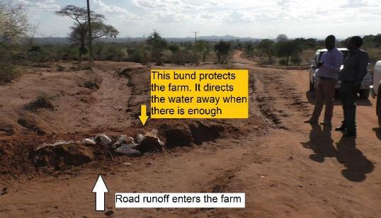
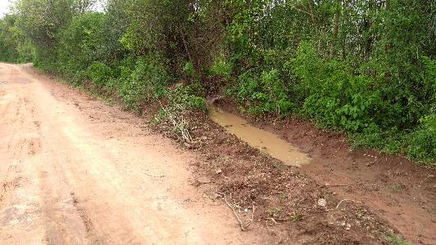
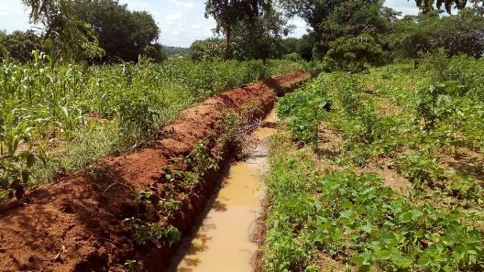
KENYA: USING CUTOFF TRENCHES TO TAP ROAD RUNOFF
Cutoff from side drain
Stored in a trench to increase soil moisture for agricultural production
Excess water redirected

Slide 28
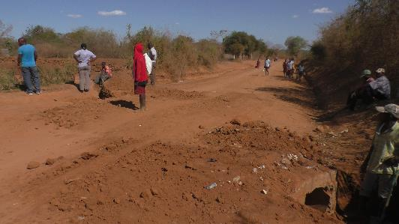
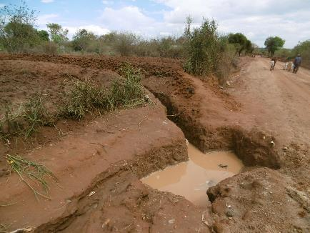
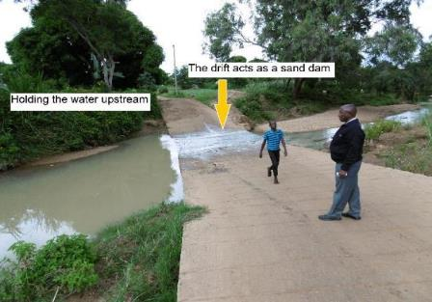
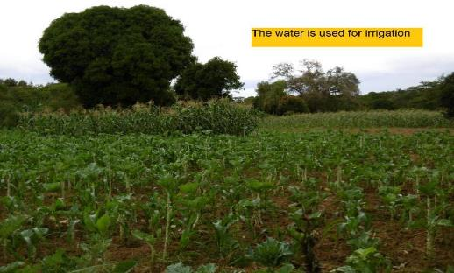
KENYA: USING CULVERTS & DRIFTS
Cross-culvert used to harvest water in a trench

Slide 29

Soaking pits along the road for groundwater recharge and increased soil moisture

Slide 30
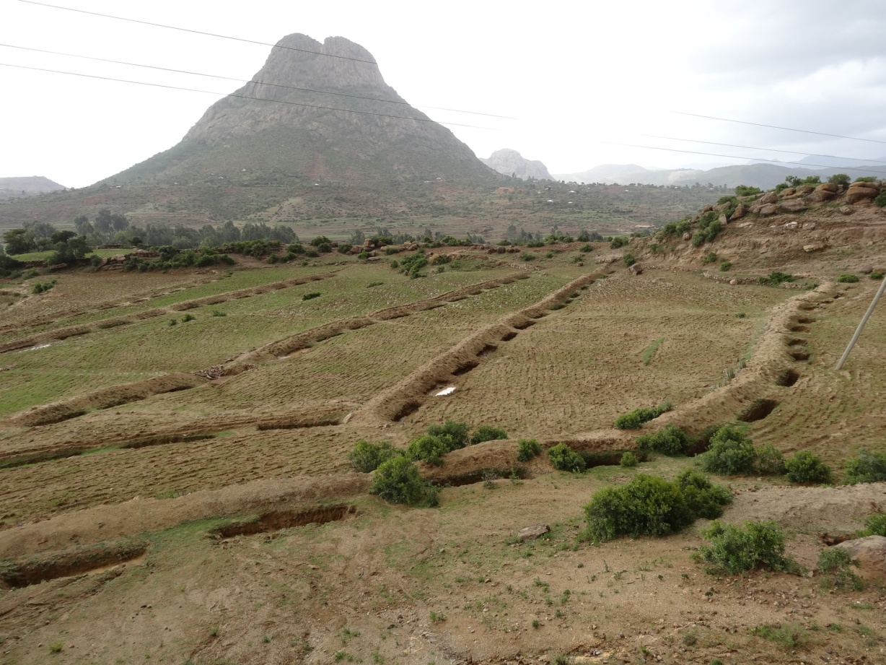
Trenches/Soaking pits for groundwater recharge and increased soil moisture

Slide 31
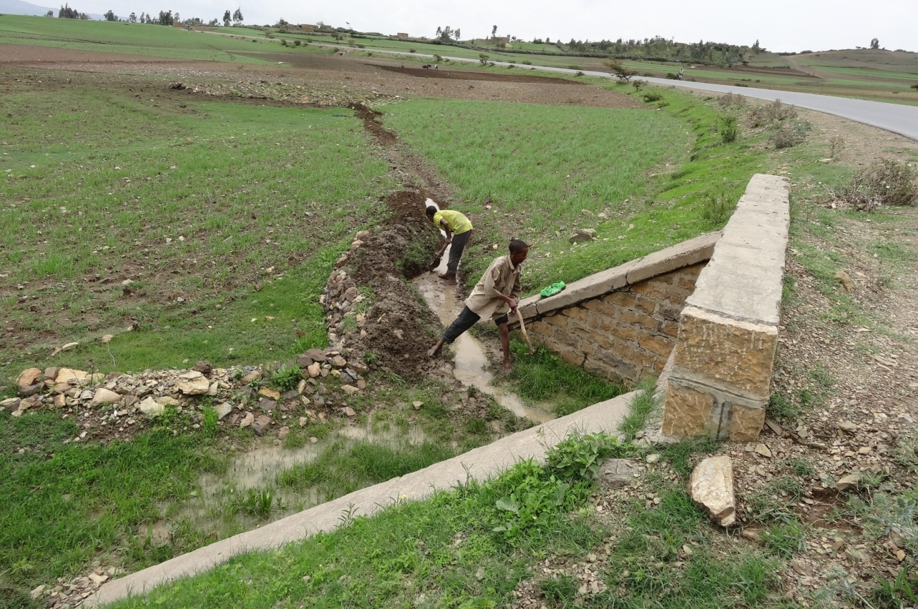
Diversion from culvert outlet

Slide 32
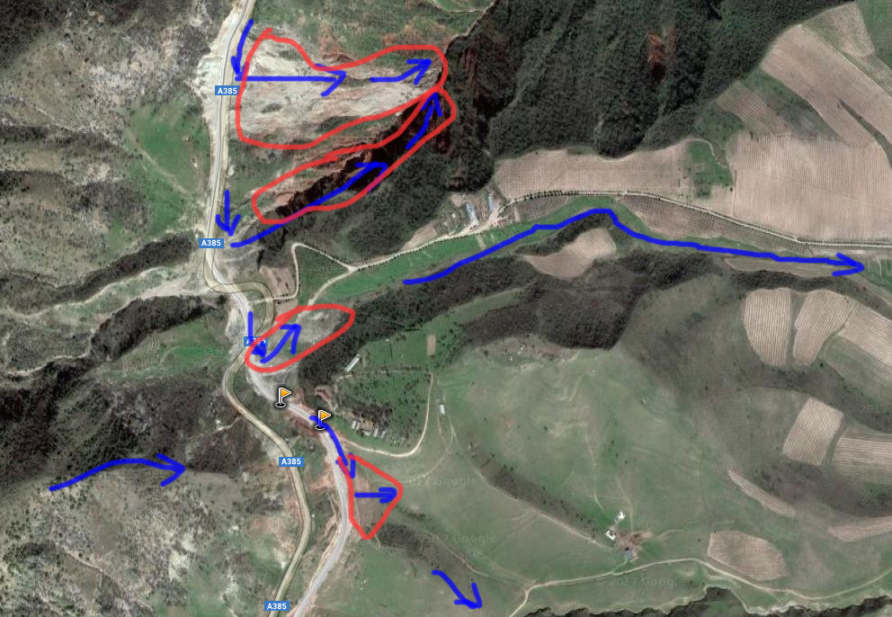

Slide 33
Elevated culverts turn roads into dams, creating shallow wetlands.
= more water, more pasture. (Olyelo wi dyel, Kotomor, Agago)

Slide 34
Many additional opportunities to better use roads for water
  Controlled sand mining along roads
  Evacuation in times of floods
  Road side tree planting
  Brick making
  Biological rodent control
  Intermediate means of transport
  >> We can turn roads into development reservoirs

Slide 35
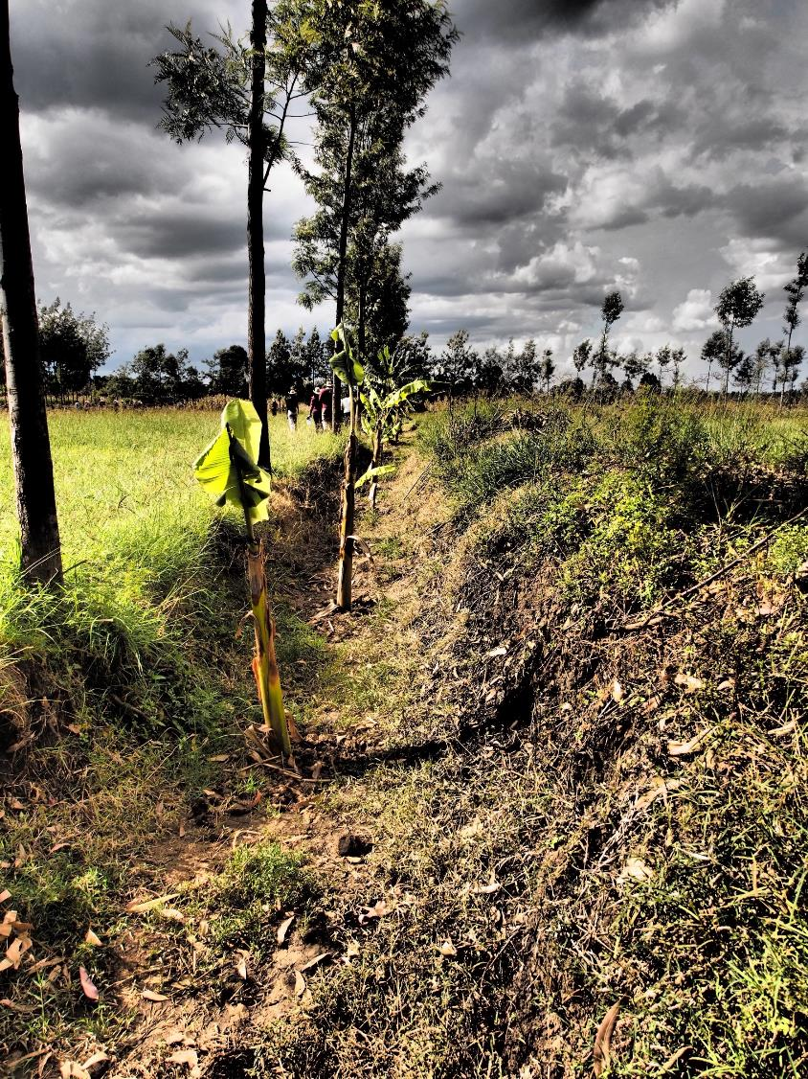
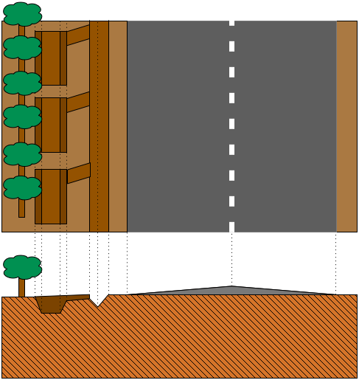
Road side tree planting

Slide 36
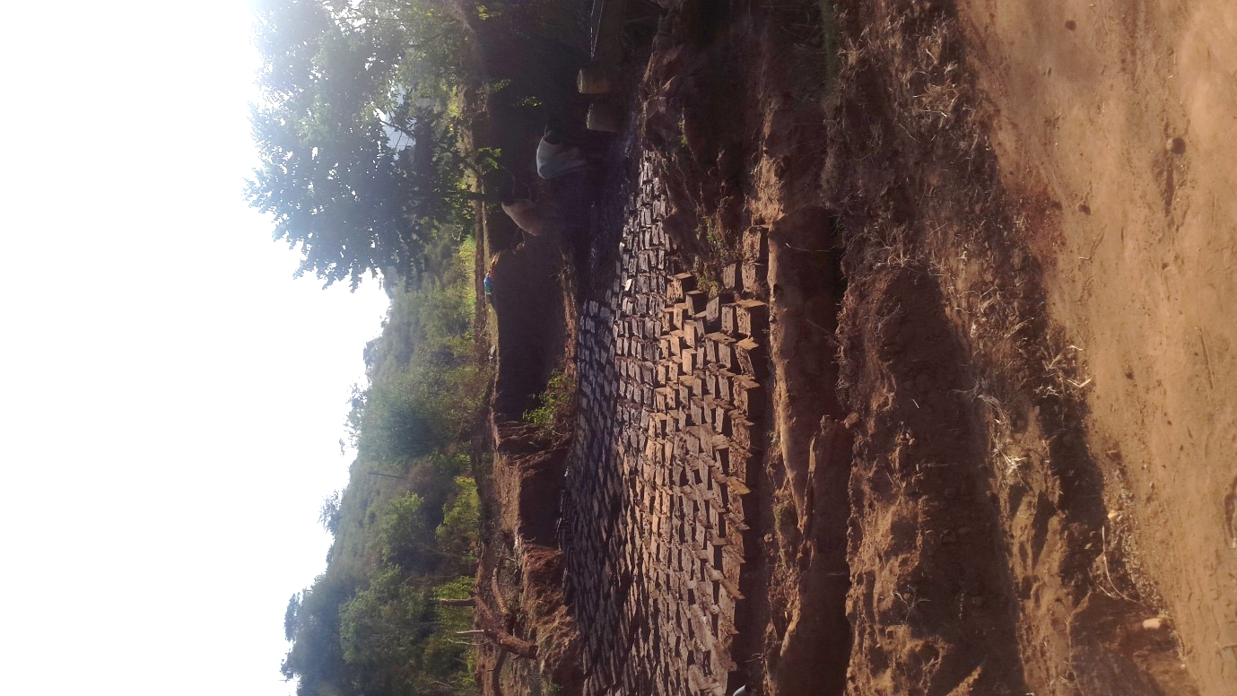
Brick making – using runoff sediments

Slide 37
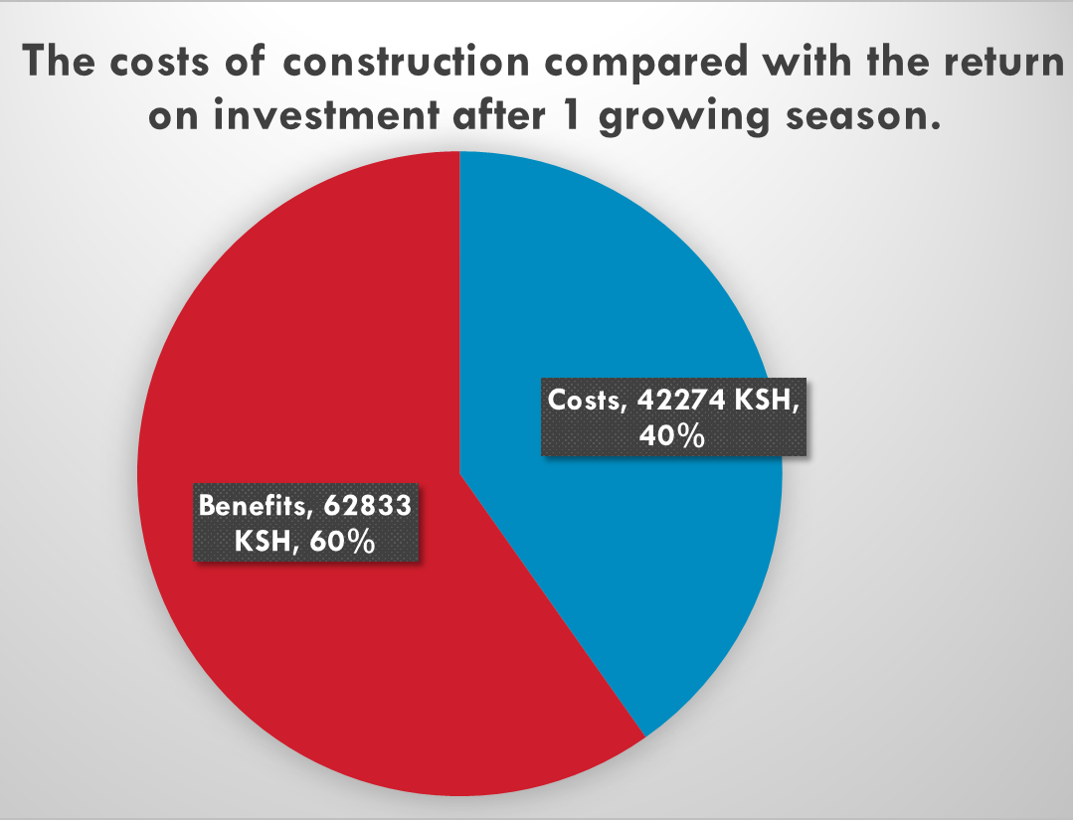
Cost Benefit Analysis
Kitui representative of 8 sub-counties (30 farms)
Mbitini (ward in Kitui County) (60 farms)

Slide 38
Beyond techniques, it’s about Governance
1. Integrate within Programs on Roads and Water and Agriculture
2. Community engagement
3. Change procedures in roads development
    Manuals
    Investment and maintenance budgets
    Cooperation
4. Capacity building
    Technical training – county staff and road engineers
    Short courses
    Tools (run-off models)
    Guided learning

Slide 39
For example: Kenya: working as partners with County Governments and Road Authorities
Technical team in Kitui, Makueni & Machakos
Cross-sectoral coordination and integration
  For all activities within the County
  Departments of Water, Agriculture, Roads & Coordination
  Representatives of ASDSP and KeRRA
Ongoing links with road Authorities to integrate in their projects and guidelines

Slide 40
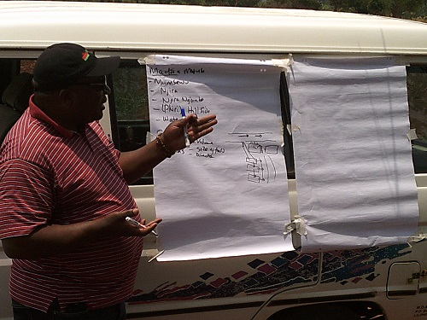
Roads for water alliance
1. Work with water/road/urban/ agriculture programs
2. Work on optimized practices
    Pilot projects
    Upscaling programs
    Guidelines and designs
3. Capacity building
    Short courses
    Guided learning
    Tools and research
  4. www.roadsforwater.org
Join us! marta@metameta.nl

Slide 41
Supported by:

