Slide 1
Green Roads for Water
Rohit Kumar Bisural, PEng (Nepal)
BE Civil, MSc Structural Engineering
Project Chief
Narayanghat Mugling Road Project
Nagdhunga Naubise Mugling Road Project

Slide 2
Green Roads for Water
Issues and challenges in strategic roads in Nepal and integration of climate change

Slide 3
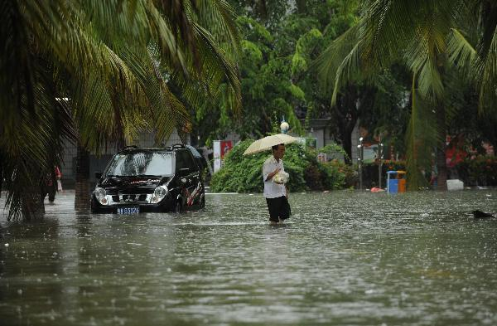
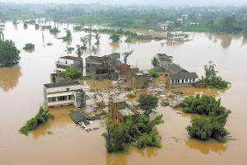
Types of Water Related Disasters in Nepal

Slide 4
Challenges, Issues
Road Engineers know that Water is the main reason for the deterioration of Pavement and Structures.
Road Water Harvesting by the side of a Highway is similar to farming the Goat and Tiger in two adjoining Cages.
Water is a Precious and Important commodity.
People surprised to see water bottle in the market at first time before 25 years in Nepal.
Water bodies along the road alignment increases the beauty. Water for Tourism purpose by the Roadside.
Today’s aim is to share about the Road water harvesting & Integration of Climate Change.

Slide 5
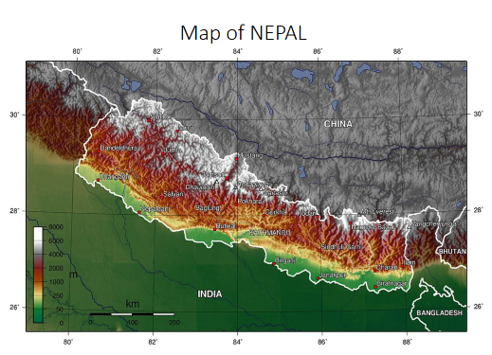

Slide 6
Green Roads for Water: Facts, Challenges
Geographical Facts of Nepal
High Himalayas
Mountains
Churia
Terai Plains
Hydrological facts of Nepal
80 % precipitation occurs within June-Sept

Slide 7
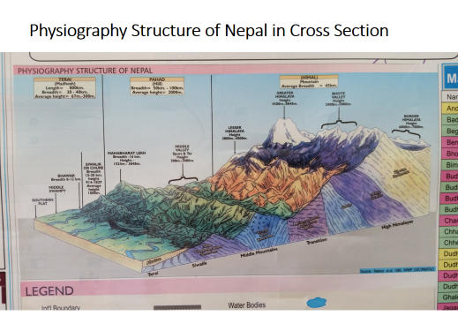

Slide 8
Green Roads for Water, Issues, Challenges
Regn | Water sources | Road Characters | Issues to Road
Himalaya | Perennial River, Snowfall | River Bank alignment | Undercutting, Landslide, Soil erosion
Mountains | Steep terrain, Perennial Rivers | High Hill cut, hairpin bends | Erosion, Slope stability, narrow space, High precipitation
Churia | River with bed scouring tendency | Road crosses the flooding river !! | Mass deposit at foot hills, River training, Forest preservation
Plains | Ground water, Tertiary rivers, Wetlands, ponds | Longer bridges, High Embankments, National Parks/sanctuary | Water logging, Flooding, Aggradation, Siltation, Wetlands Preservations, Inundation plains

Slide 9
Water harvesting techniques for Resiliency in Nepal
S No | Region | Engineering Techniques, Suggestions
1 | High Himalayas | Select Appropriate cross drainage structures at proper location. Collaborate with the Hydropower Projects. Storage type hydro power plants ? Customize design standards ---- Low Traffic, Limited space, Low speed.
2 | Mountains, Mahabharat | Preserve water source in consultation with the local community. Construct water storage tanks by roadside. Rainwater collecting system. Drip Irrigation/ Sprinkler Irrigation.
3 | Churia Hills | Construct structures strong enough to withstand the heavy bed load during flooding. Go for minimum disturbance to the water. Extract the natural resources such as gravel, sand, boulders with proper study of site. Recharge systems.
4 | Terai Plains | Construct Irrigation Canals in collaboration with the Road Authorities. Preserve wetland/ponds by realigning the highway. Construct the inundation channels, River training, Bunds Gates, Weirs. Go for Ground water harvesting. Low height highway embankments. Burrow pits by the roadside with careful study of water course nearby.

Slide 10
Resilient Structures, Future actions
S No | Action Recommended/Suggested | Responsible agency
1 | Study and comply the climate change issues on design phase of road. Water Auditing | Road building agency
2 | Prepare the inventory of existing water resources around the Road alignment Rivers Cascades Ponds/Lakes Wells/Springs | Federal/Local Government
3 | Prepare master plan for the preservation of water bodies for resilient road | Federal/Local Government
4 | Explore for the alternate water resources along the Road alignment such as Snow harvesting, Reservoir, Fishery, Forestry | Federal/Local Government

Slide 11
Green Construction with water
Select local drought tolerant vegetation to form diversity and comprehensive optimization of water-saving landscape.
Construct High efficiency water saving irrigation green technology by sprinkler irrigation and drip irrigation.
Use the 100% of reclaimed rainwater to irrigate the green landscape.
Water saving and water
resources utilization
Improve water use efficiency
Non traditional water resources utilization
Water safety

Slide 12
Resilient Structures, Suggestions
Planning of Large cities in Terai area needs multidimensional projects with several sectorial experts in it so that development of Road, Irrigation, Water supply, Sewerage, Land development, Water preservation could be done in collective way. Independent powerful authority ?
Study for possibility of Sponge city, Spongy Road in some area of Terai.(Shanghai)
Plan for Waterway wherever feasible (Su Zhau, Venice)

Slide 13
Policy level suggestion
No water bottle/jar from other Local Level ?
Or
Use water from within the boundary of your own Local Level

Slide 14
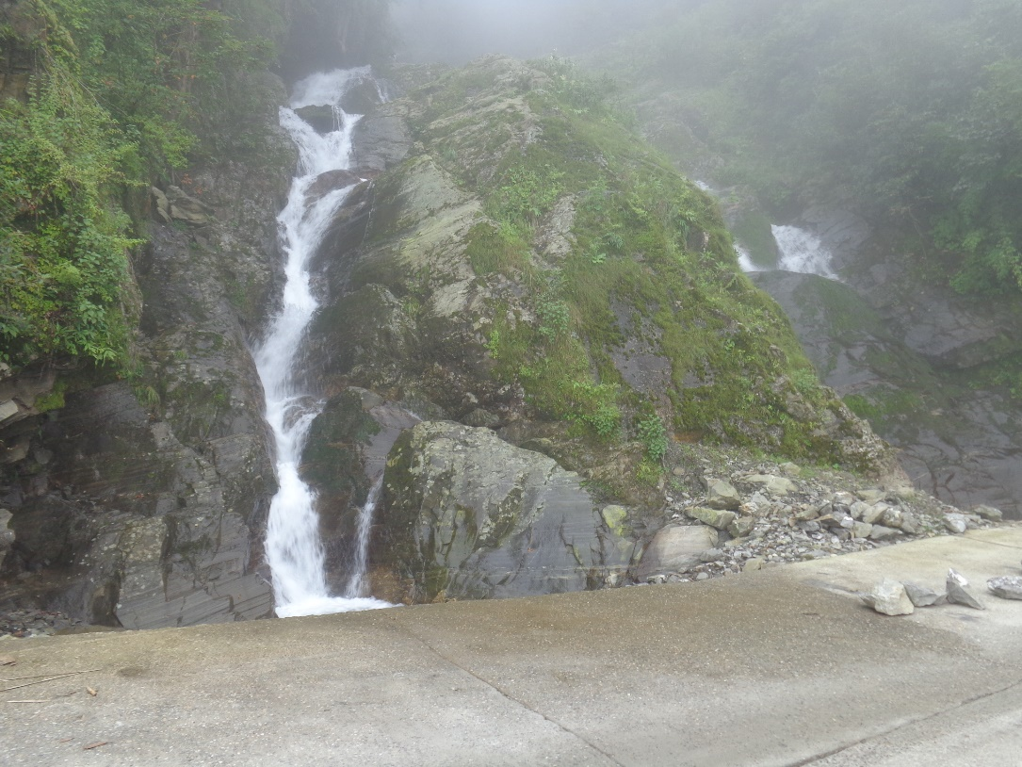
Source of Water/ Natural Gift
Natural Cascade at Kathmandu Rasuwagadhi Road side
A touristic value

Slide 15
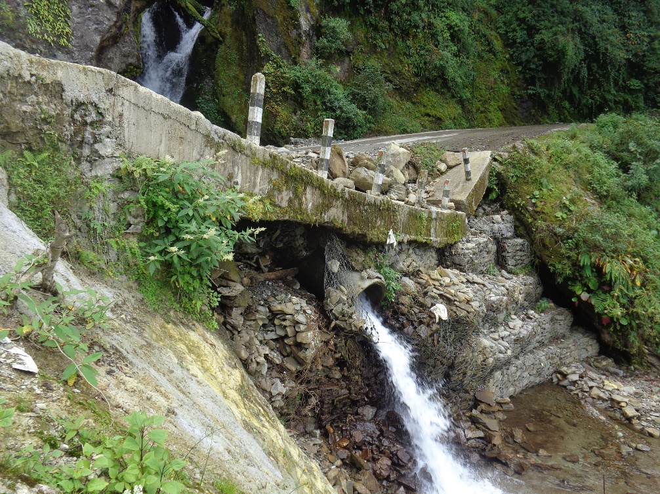
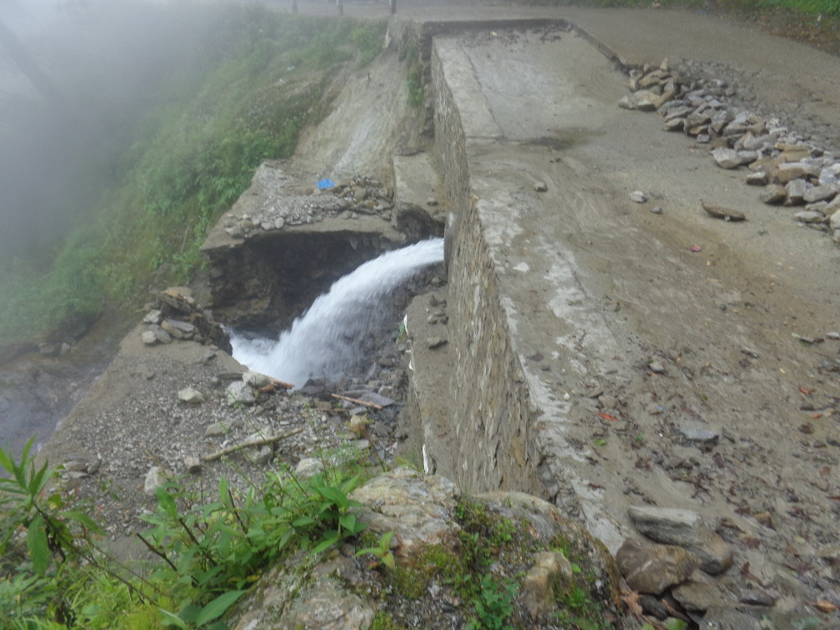
Roadside water/ Trouble to Road Engineers
Kathmandu Rasuwagadhi Road

Slide 16
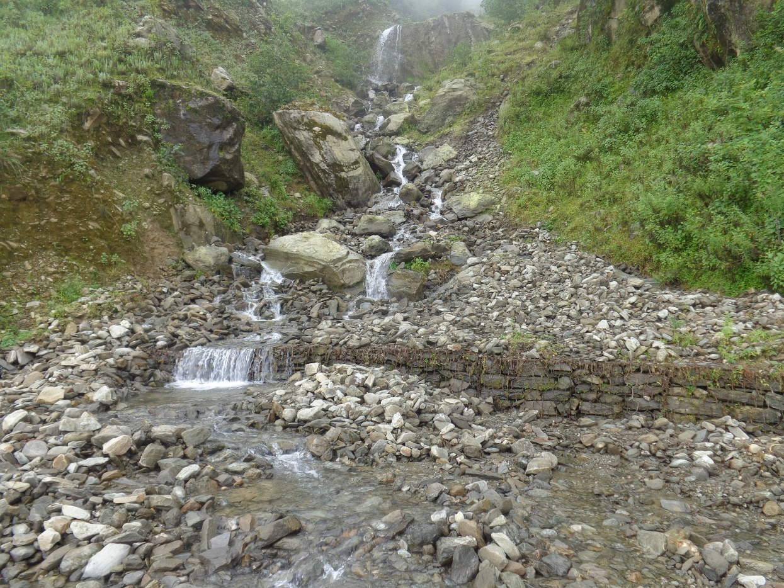
An Stream across the road section: Challenges
Ramche Rasuwa

Slide 17
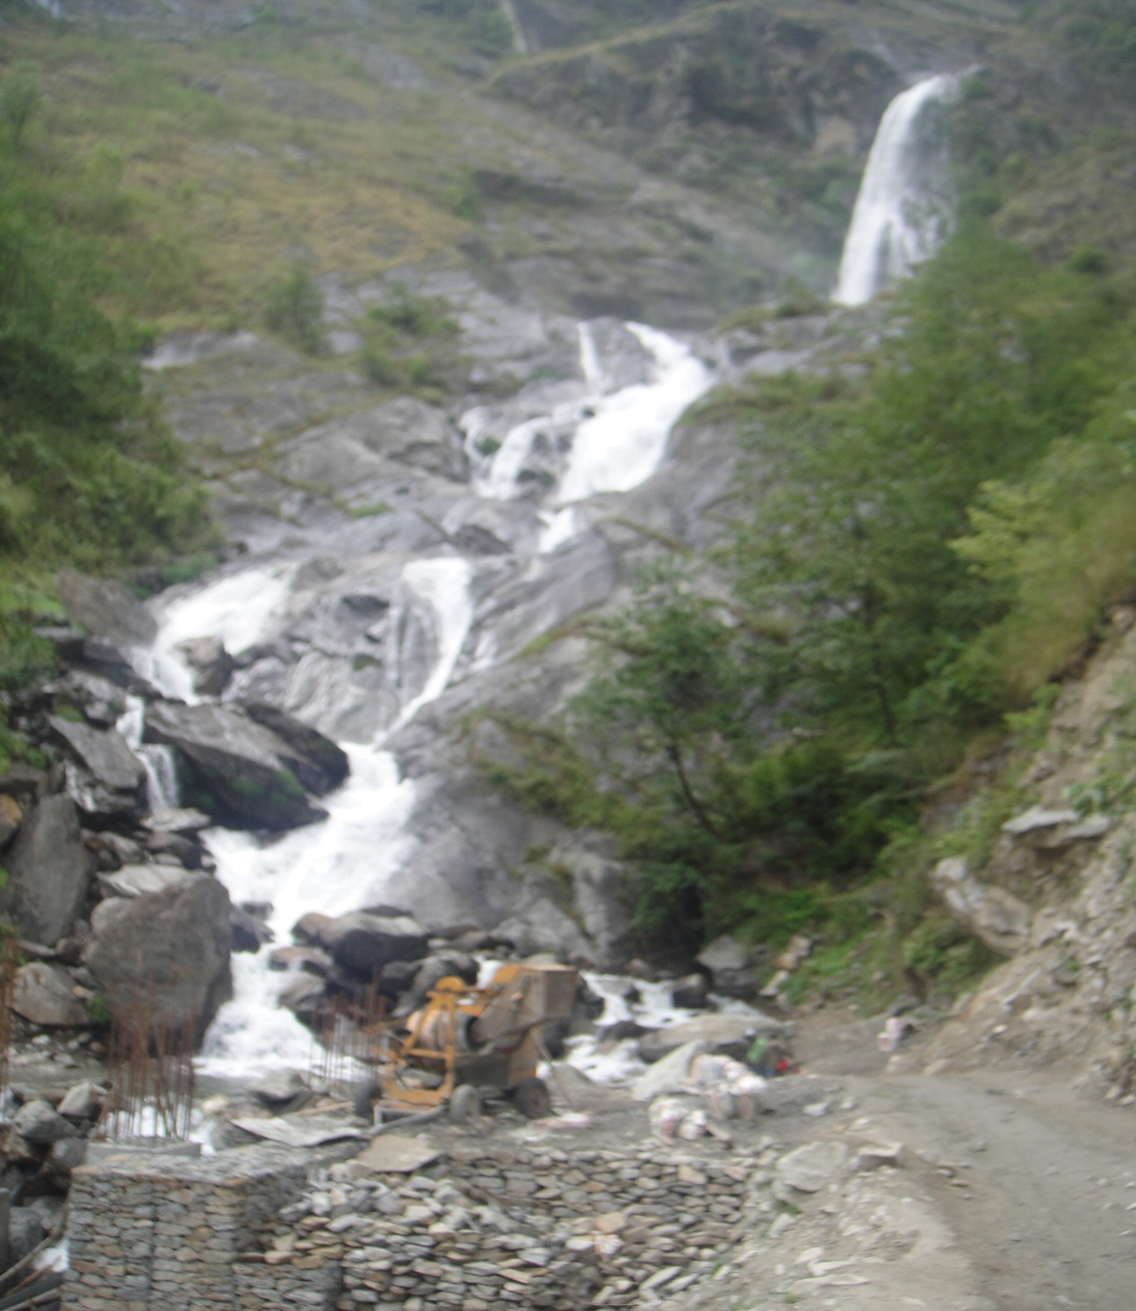
Green Roads for Water
Rupse Fall along the Road to Mustang: Opportunity
Touristic value

Slide 18
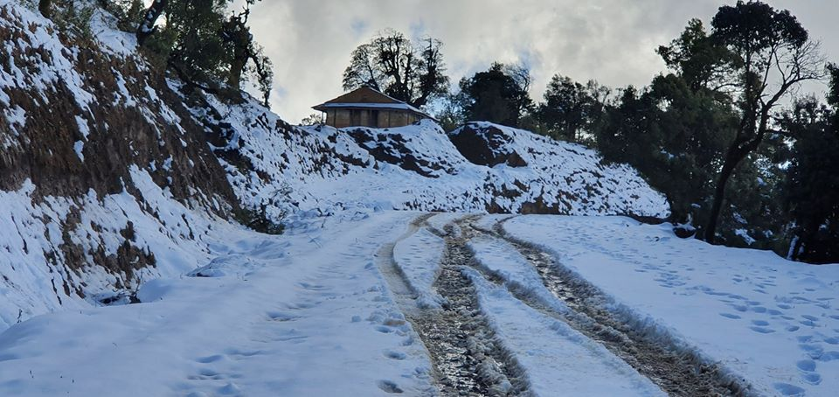
Snowfall along Mid-Hill Highway, West Nepal : Opportunity for snow water harvesting

Slide 19
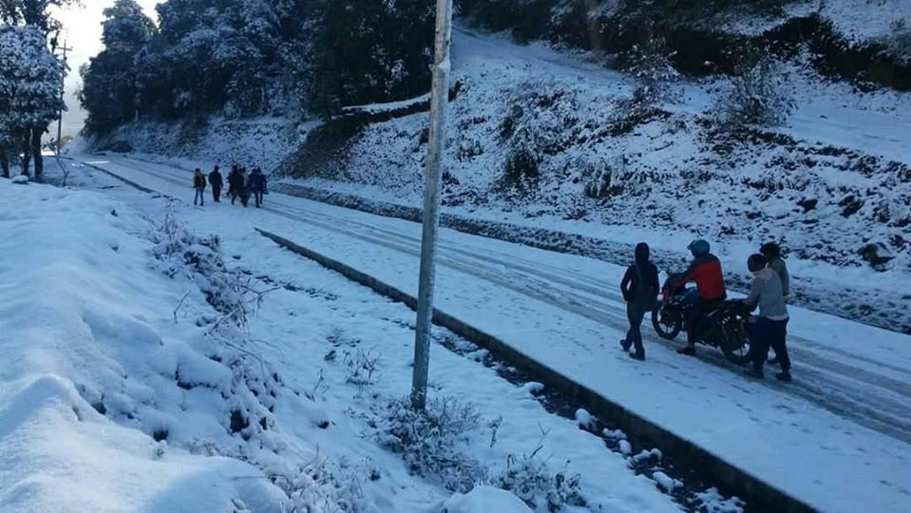
Snowfall in Midhill Highway at East Rukum
Opportunity and Challenges

Slide 20
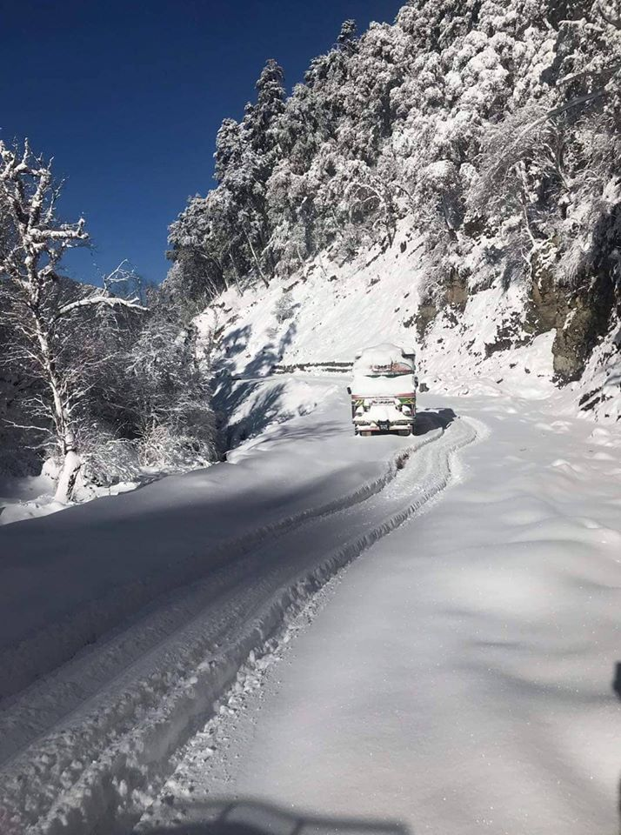
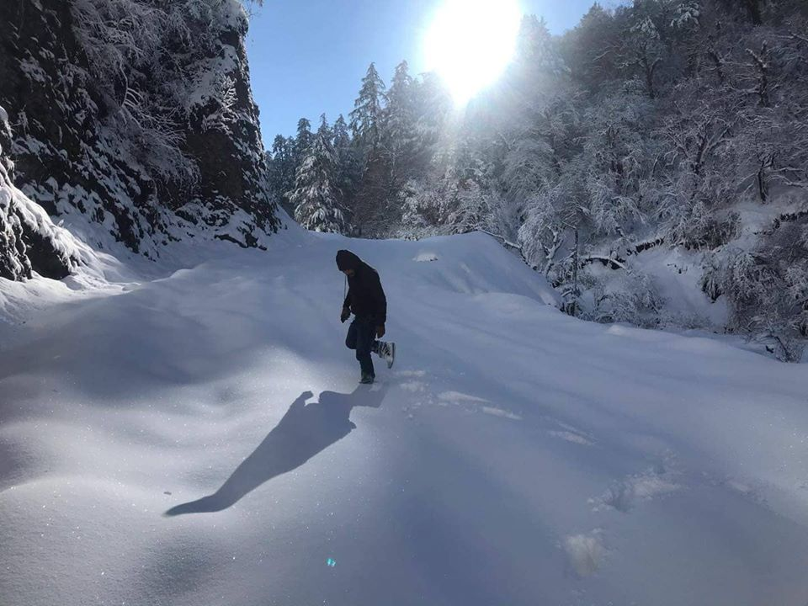
Snowfall in Mid hill Highway, Challenges

Slide 21
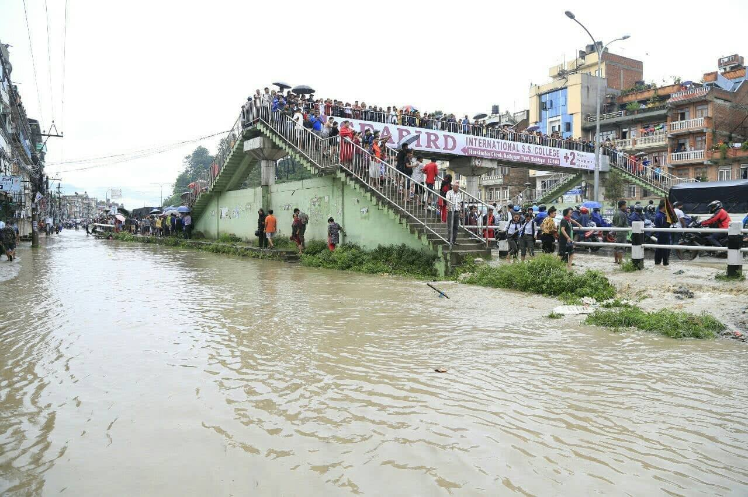
Flood damage at Kathmandu Bhaktapur Highway, Challenges

Slide 22
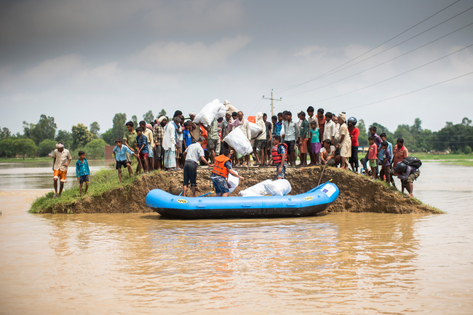
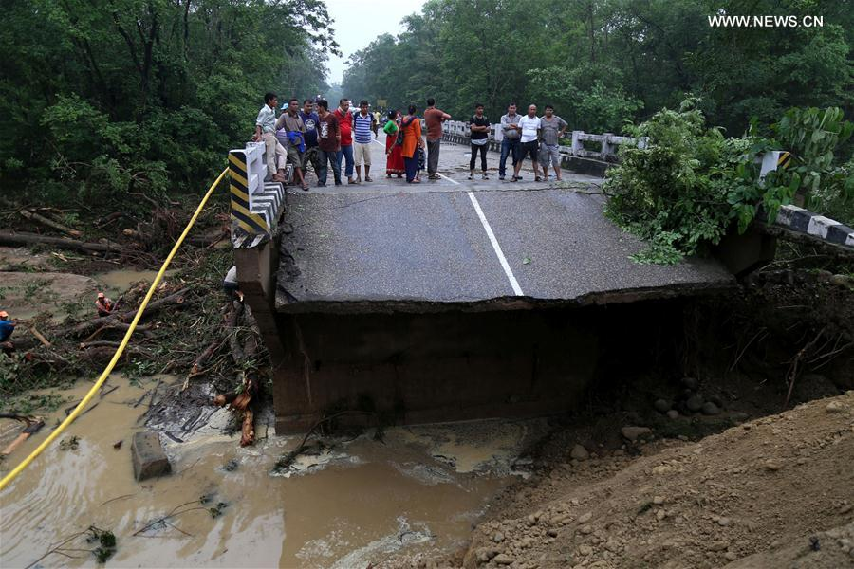
Flood Damage in Terai Roads, Challenges

Slide 23
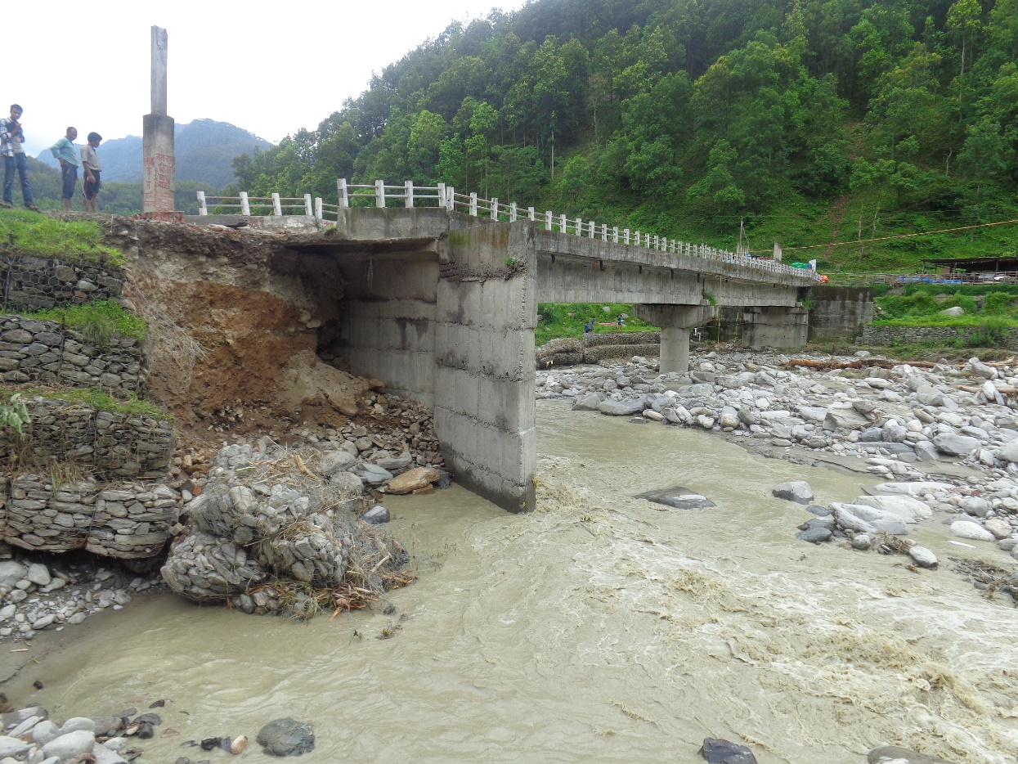
River current eroding the banks of a Bridge Approach at Nuwakot, Challenges

Slide 24
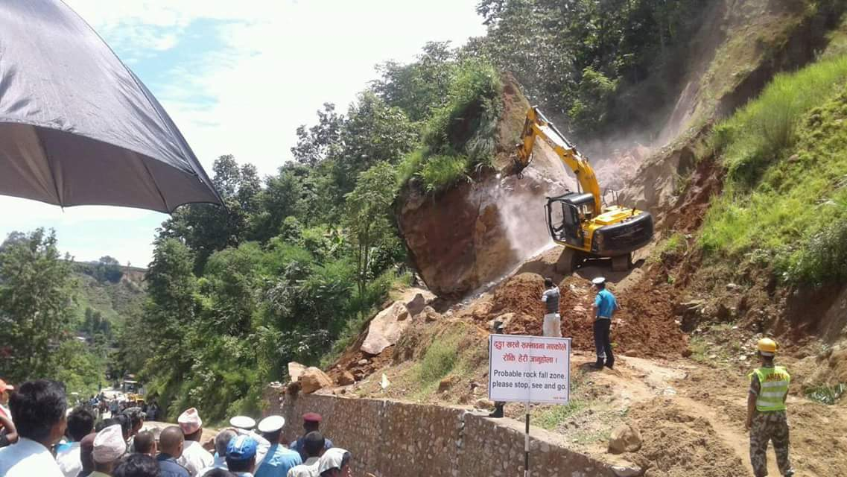
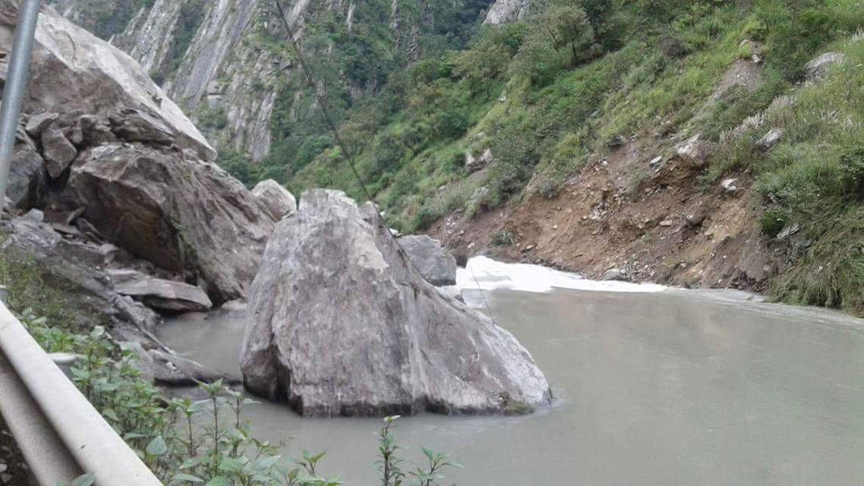
Landslide/Rockfall from hillside troubling Road and River: Challenges at Rasuwagadhi Road

Slide 25
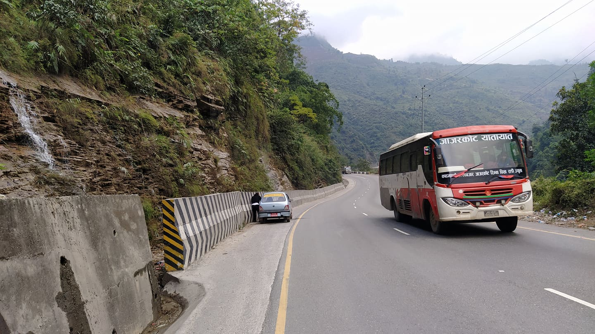
How to integrate for Resiliency
Lets find ways for the peaceful coexistence of Road with Water.
It is possible by proper planning of Roads at Design Phase.
It comes out to be cost effective in long term

Slide 26
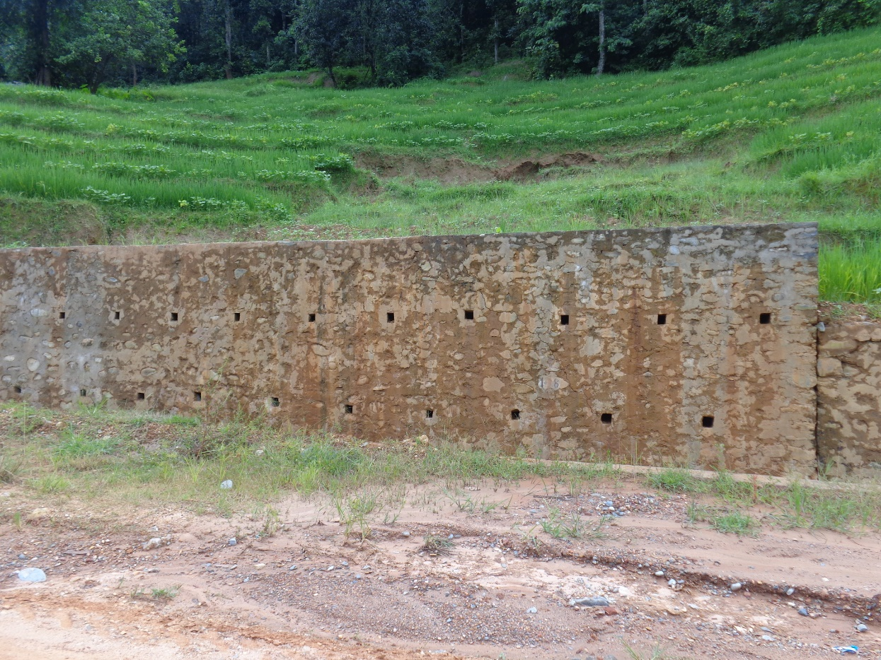
Learning by Doing
Saturated Soil Mass with water at the paddy field pushing the breast wall hill side of a Road
Provide weep holes, Collect water at drain & Channelize

Slide 27
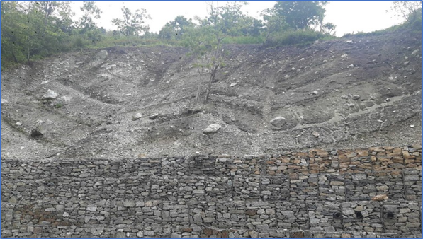
Best Practice, Bioengineering
Slope Stabilization and Preservation of Natural source of Water at 27+400 KM of NM Road

Slide 28
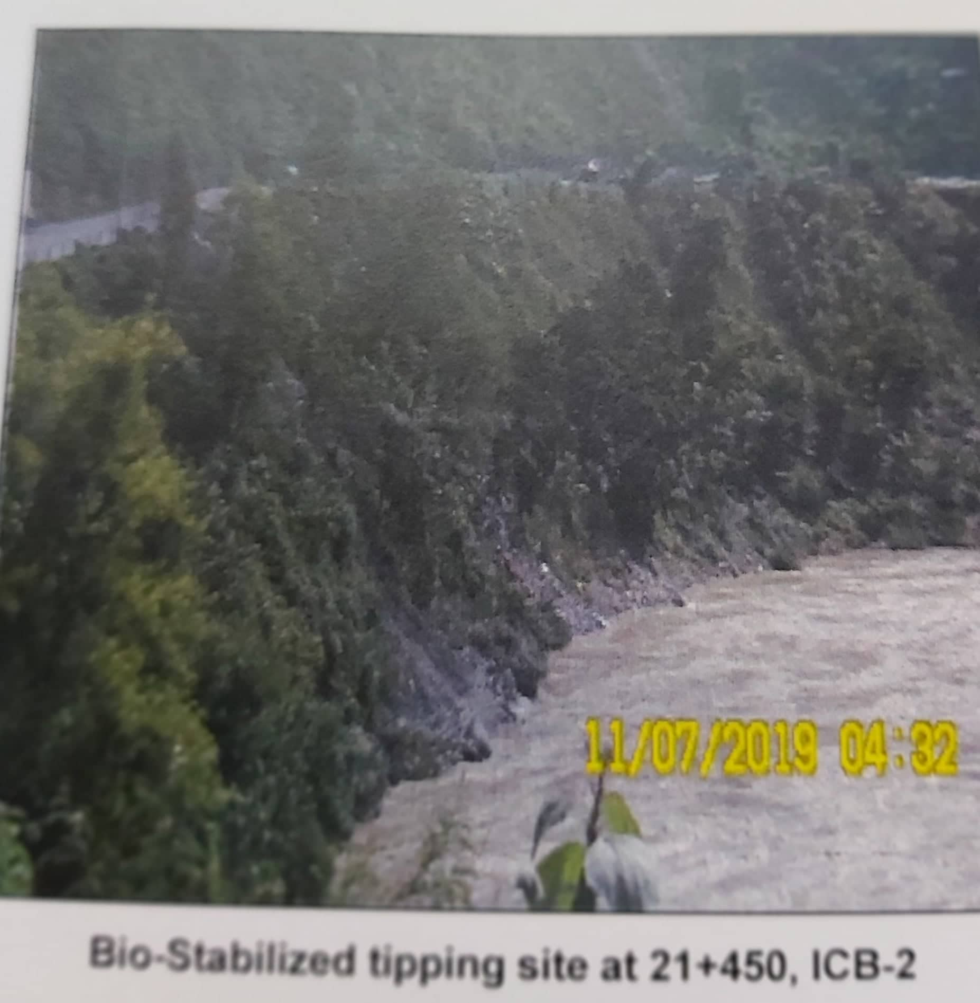
Best Practice, Tipping site with Preserving Environment at NM Road

Slide 29
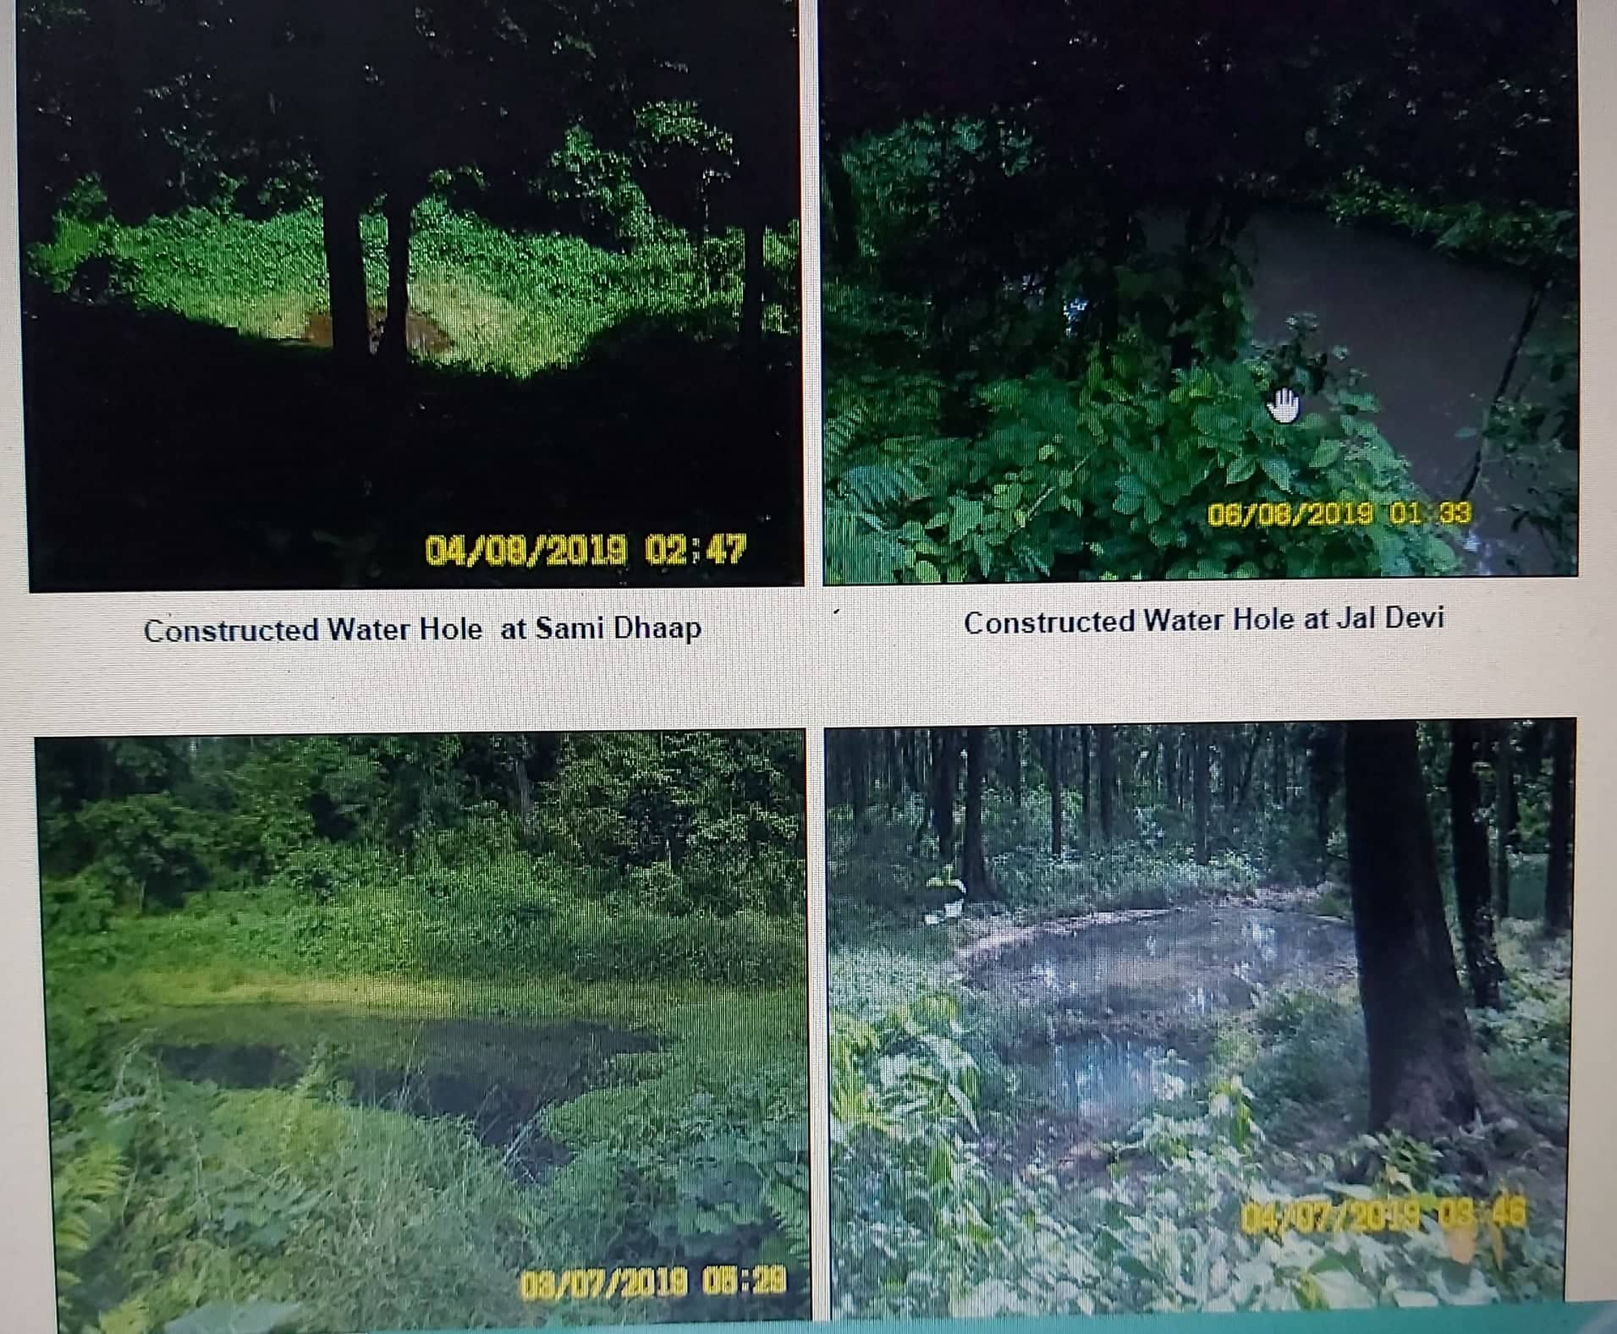
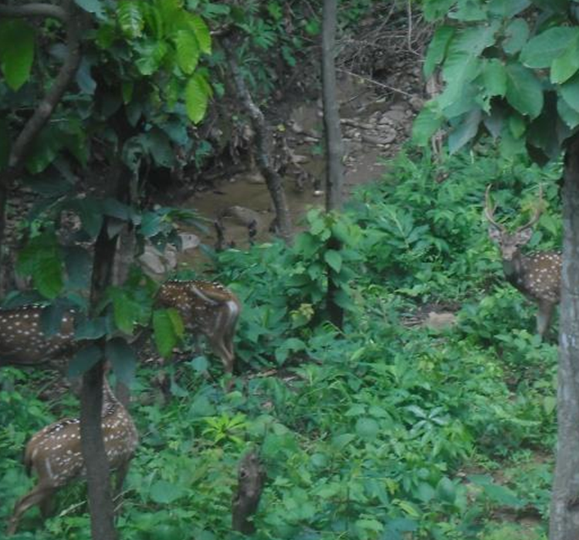
Best Practice: Water holes constructed at Forest nearby along NM Road for Wildlife preservation

Slide 30
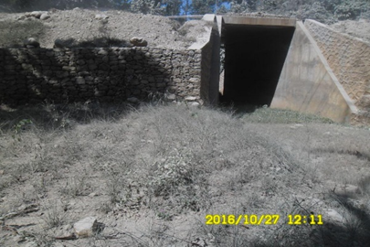
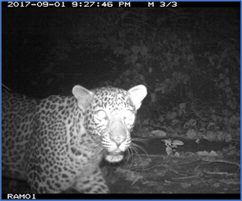
Best Practice: Attempting to preserve the habitat of Wild life by the construction of animal underpass at NM Road

Slide 31
Thank You
For Your Attention

