Slide 1
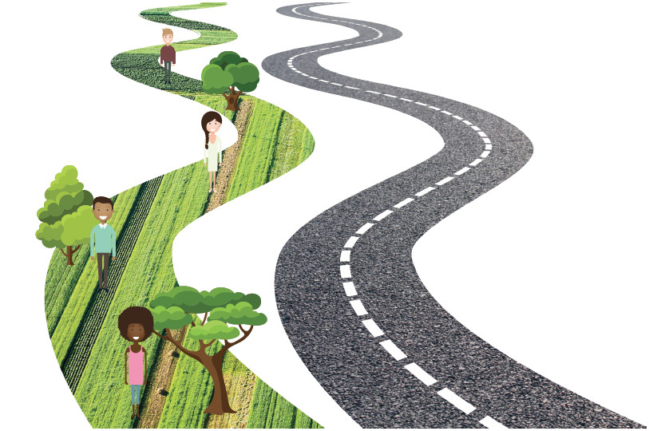
Roads as Instrument for Climate Resilience: The World Bank Guidelines
Frank van Steenbergen
fvansteenbergen@metameta.nl

Slide 2
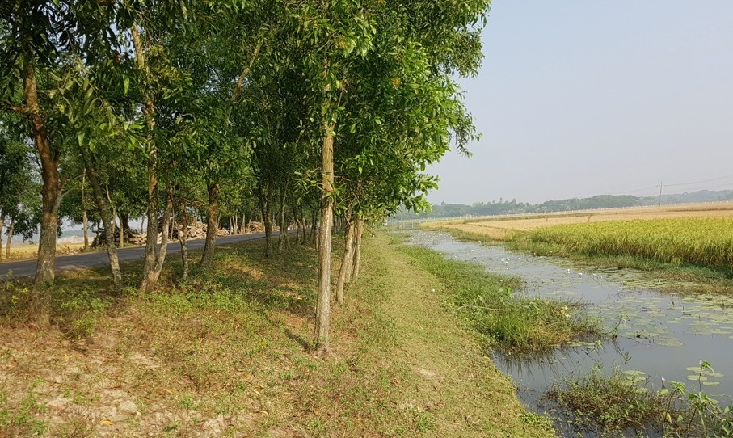





Roads are everywhere and are a massive lever
20% of the world within 1 km of a road
Can we think of making roads instruments for resilience, for better water management, regreening – i.e. not protective but instead pro-active?
YES
We can
&
We should

Slide 3
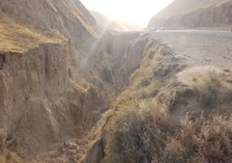
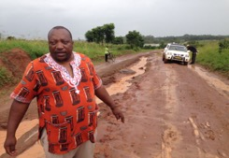
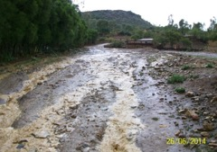
At present, REALITY is different...
Erosion and sedimentation
Roads are a major cause of:
Local flooding
Water logging
(crop loss and health problems)
Dust
(Health problems and crop loss)

Slide 4
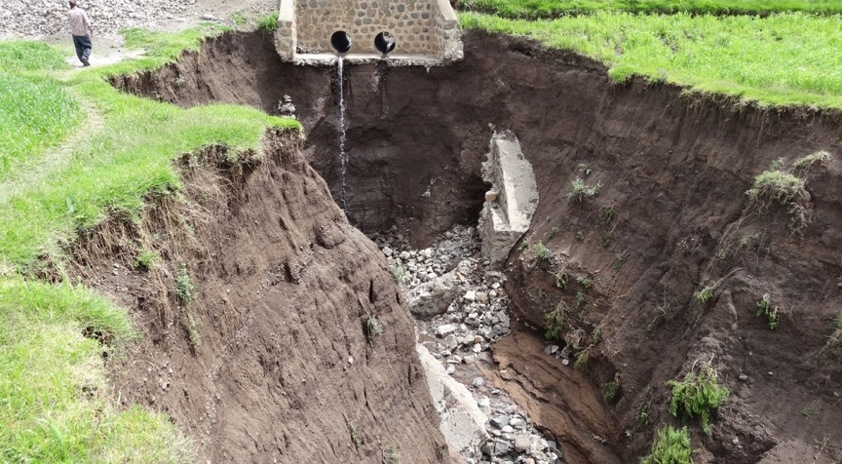
What is happening here?

Slide 5
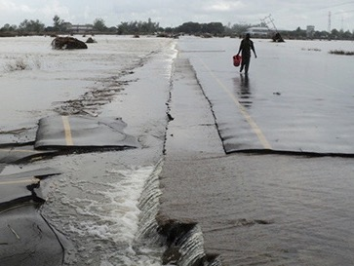

Roads have a major imprint on hydrology, acting as a barrier or drain
This can be
roads can become
GREEN ROADS
Turned
around

Slide 6
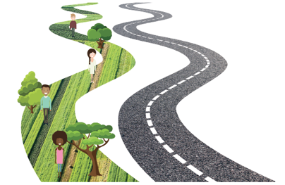
What Are
Green Roads for Water?
Roads that have secure transport functions
Roads that actively increase climate resilience
  Roads that are instruments for water management
  Road that are used for flood protection and flood relief
  Roads that stem erosion and promote good land management
  Roads side vegetation that sequesters carbon, controls dust and filters effluents

Slide 7




Why Green Roads:
Big Scale and Big Impact
Case Load
Roads are major investment globally
(1-2 Tr USD/year)
Road network in SSA is to increase to 2.8 million kilometer by 2025 (up 80%)
Cost of climate proofing transport infrastructure in Asia USD 37 Bn/yr
At same water causes 35-80% of road damage
Impact now often negative: turn around ‘green roads’ as instruments for (climate) resilience, beneficial water management and dust control
Roads are one of the major impacts on (surface and subsurface) hydrology and flood patterns and air quality

Slide 8





Why Green Roads:
Big Scale and Big Impact
Case Load
Many tested Green Roads measures exist, suited to different geographies
Green Roads can be a main instrument for climate resilience, health and increased agricultural production: multiple co-benefits
Measures are low cost in comparison to total road investment (<5%) – and often saving cost of investment and maintenance
Rate of return high
(>4 in a year)

Slide 9
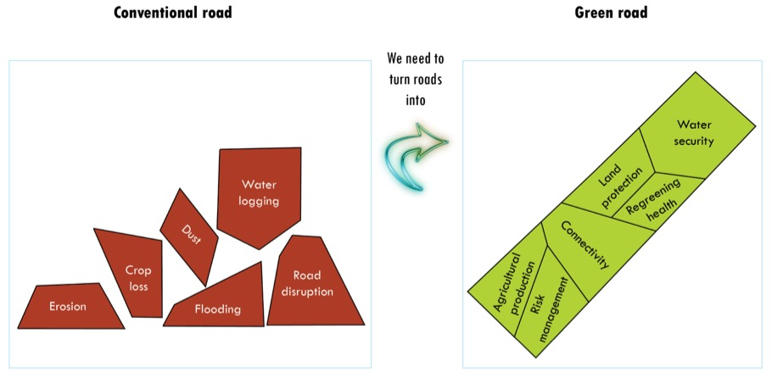
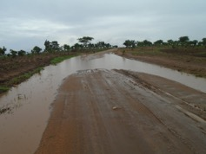
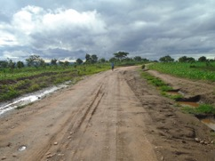

Slide 10
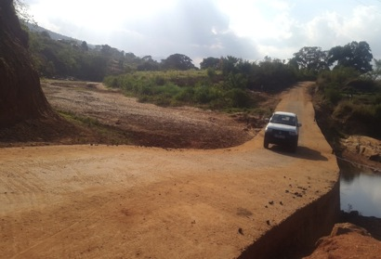
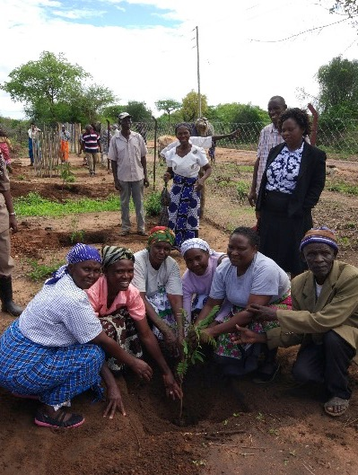
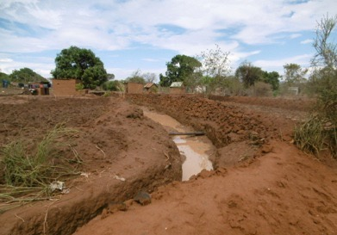
Many Opportunities: World Bank Guidelines
Retaining water with road drifts
Feeding soil moisture with road drainage
Road side tree planting

Slide 11
Roads can:
In arid areas, roads can be used to harvest water.
Roads can also be used to manage water catchments by controlling the speed of runoff, compartmentalizing and mitigating flood runoff, and influencing the sedimentation process in the catchments..
In floodplains and lake sides, roads play a role in flood protection. Roads often double as embankments and provide evacuation routes and flood shelters. In low-lying wetland areas and floodplains, roads and bridges affect the shallow groundwater tables and have enormous consequences for land productivity.
Roads can improve pastoralist areas for instance by combining the concentrated run-off from roads with planting native grass species.
Roads can also be used to control sand dune movement.
Roads may serve to protect wildlife areas

Slide 12
Level of Road Resilience | 0 | 1 | 2
 | Basic Resilience: Protective | Resilience Plus 1: Adaptive | Resilience Plus 2: Proactive
Key words | Protecting road infrastructure | Making best use of and adapting to changed hydrology | Redesigning road infrastructure to optimize the area’s water management/climate resilience
Geographies
Semiarid areas | Catchment measures to reduce water damage to roads | Use runoff guided from roads for recharge and storage; upper catchment protection | Design roads and cross- drainage facilities to collect runoff and guide to recharge area
Watersheds and catchments | Catchment protection to protect road infrastructure | Catchment protection to protect road infrastructure | Plan road alignment and drainage structures in support of catchment management
Coastal areas and floodplains | Increase height of flood embankments to deal with higher floods | Convert village roads for water-level management with gated structures | Consider low embankment roads with controlled floodways develop road levees in flood-prone areas; use roads for land accreditation
High- and medium-altitude areas | Have safe road water crossing and protection measures; have adequate road drainage; reconsider road alignment to higher areas; train mountain rivers to reduce exposure of roads to mountain floods | Using water-retention and land-management measures suitable to mountain areas to stabilize mountain catchment and retain moisture and snowmelt; systematic spring management | Use cut and fill instead of cut and throw methods; observe maximum slope and gentle alignments; combine roads with additional storage to and drift for torrent stabilization
Desert areas |  | Revegetation and dune stabilization using road runoff Develop small roadside oases taking road runoff to depression areas | Adjust road directions to deal with wind directions to control sand dune formation

Slide 13
Level of Road Resilience | 0 | 1 | 2
 | Basic Resilience: Protective | Resilience Plus 1: Adaptive | Resilience Plus 2: Proactive
Key words | Protecting road infrastructure | Making best use of and adapting to changed hydrology | Redesigning road infrastructure to optimize the area’s water management/climate resilience
Bridges | Increased dimensions to accommodate flood peaks and prevent flood congestions; deepen abutments | Integrate bridge crossing in catchment management to reduce riverbed siltation and mitigate flood peaks | Use bridge sills for controlled drainage and wetland management; consider drifts instead of bridges to stabilize riverbeds
Drifts | Higher spillways and larger aprons to accommodate peak floods | Use drifts and small fords to stabilize erosive streams | Use non-culvert drifts for water retention, river stabilization, and flood water spreading
Paved roads | Increase capacity of road drainage; reinforce drainage infrastructure; build more weatherproof road surfaces, impermeable pavements, and embankments | Manage catchments to retain water and control erosive runoff to reduce risk to infrastructure | Consider changed alignment and cross drainage for water storage and recharge
Unpaved roads | Increase cross drainage and protect road surface with additional layers of aggregate | Catchment management (see above); Protect road surface with water bars, dips, and infiltration bunds | Include basic drainage for water harvesting as part of road development; take measures to manage subsurface flows; protect catchments
Roadside slopes | Adjusting critical slopes | Bio-engineering and vertiver planting for productive use
Drainage structures | Increase dimensions to accommodate larger flood peaks | Implement gated control and water spreading from culverts and drains | Place culverts to optimize drainage pattern for water harvesting
Borrow pits |  | Systematically convert borrow pits for storage, seepage, or recharge | Plan new borrow pits to optimize storage functions after conversion
Roadside vegetation |  | Systematically promote roadside planting for sequestration and better dust control and microclimate

Slide 14
 | Prime challenges | Techniques
Semiarid areas | Water harvesting Water retention Erosion control | Flood water spreaders Flood diversion from culverts Infiltration trenches and other recharge techniques Surface storage including borrow pits and farm ponds Raised road embankments for water retention Road drifts as sand dams

Slide 15
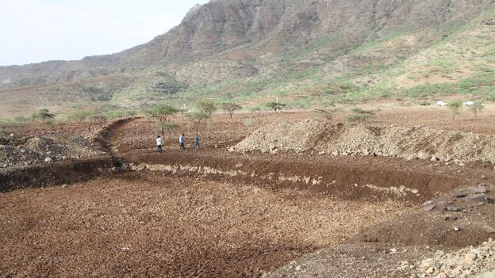

Slide 16
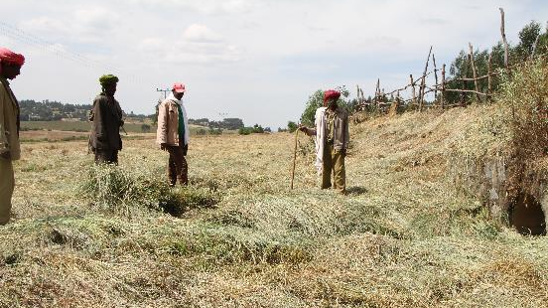

Slide 17
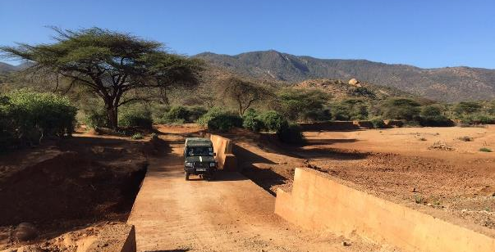

Slide 18
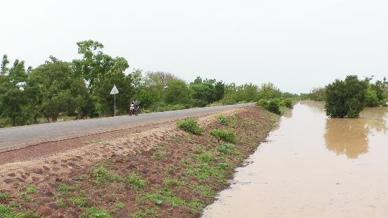

Slide 19
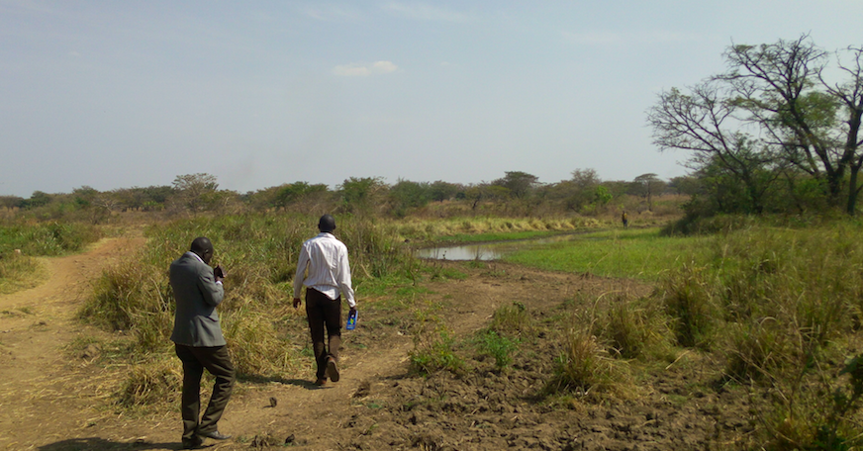

Slide 20
 | Prime challenges | Techniques
Watersheds and catchments | Water harvesting Erosion control Flood control | Choosing road alignment Culvert placement and design Road drainage Water harvesting and erosion control structures Road drift and platforms Warping dams

Slide 21
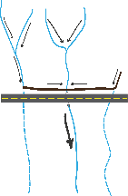
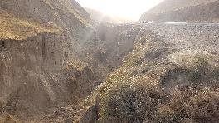
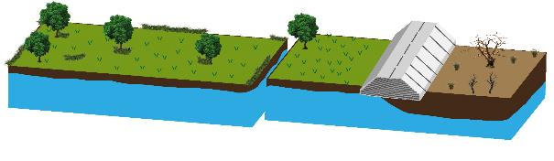

Slide 22
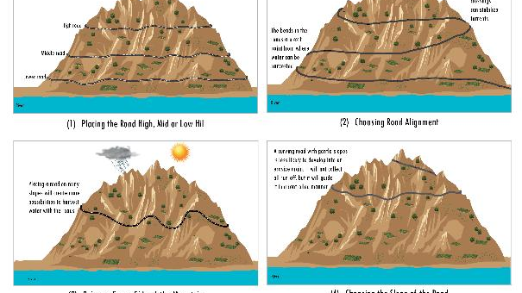

Slide 23
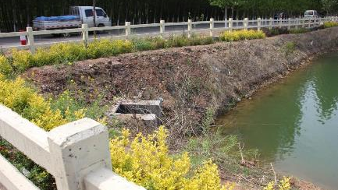

Slide 24
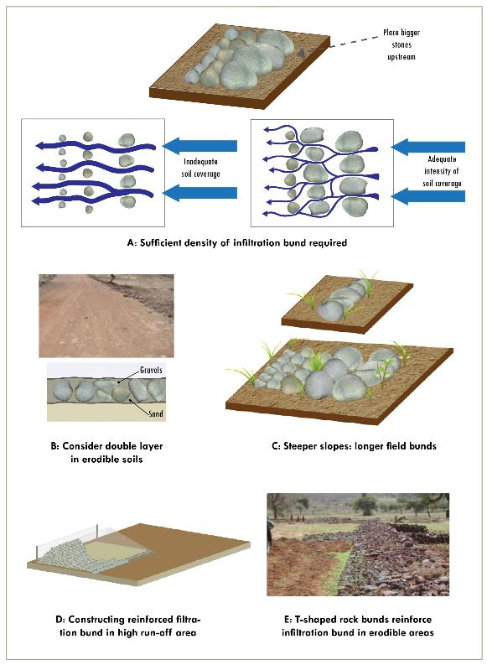

Slide 25
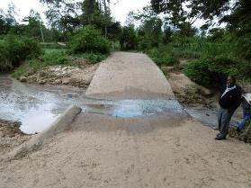

Slide 26
 | Prime challenges | Techniques
Plains | Water table control Drainage Water storage Flood protection Flood relief | Road alignment and heights Cross drainage and gated culverts Borrow pits Fish passages Levees and flood shelters Evacuation routes Low embankment roads Submerged roads Bio-engineering and turfing

Slide 27
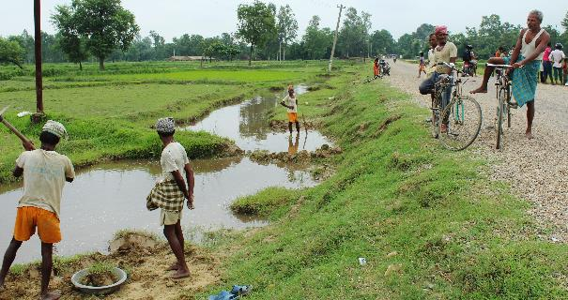

Slide 28
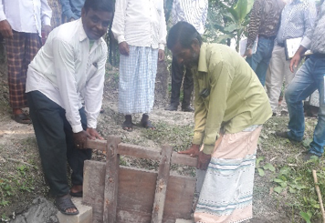

Slide 29
 | Prime challenges | Techniques
Rural water supply | Source augmentation Water quality | Grass strips/ecological water control Recharge from roads Surface water storage Spring management

Slide 31
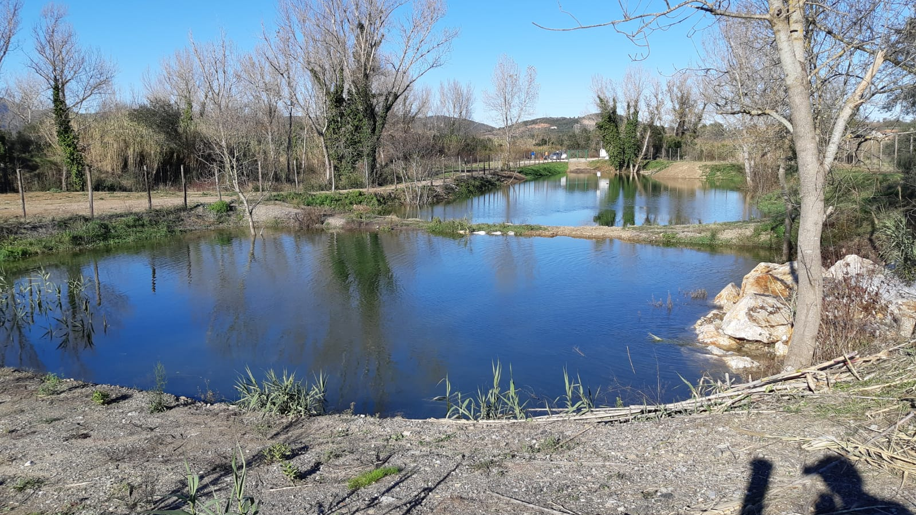

Slide 32
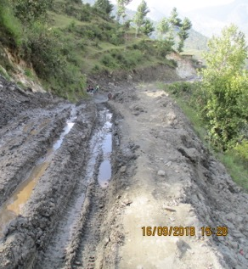
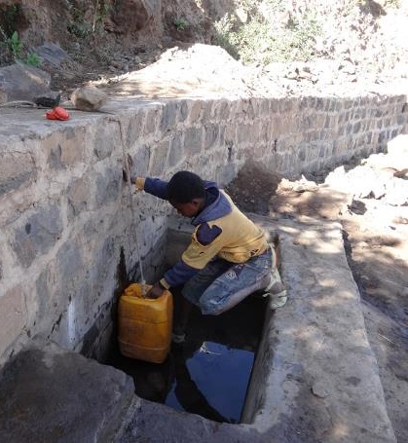

Slide 33
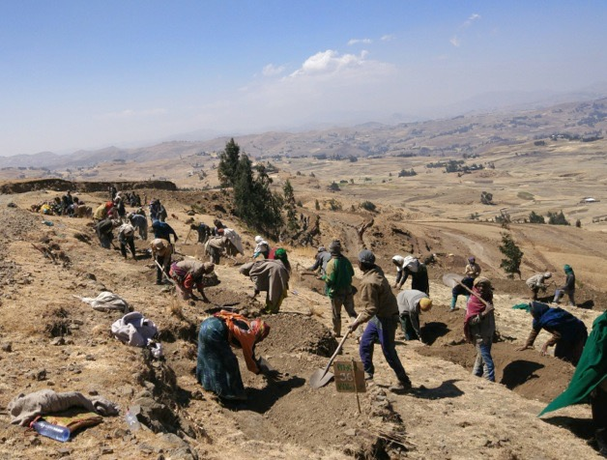


Road Water harvesting campaigns
> 4 Million people benefitted since 2015

Slide 34
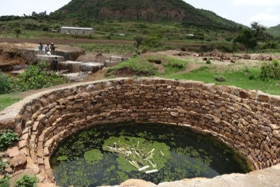
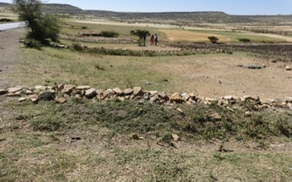
Impacts
Effects on soil moisture from road spreader

Slide 35
Link resilience certification of road projects to finance
(World Bank Global Guidelines)
Road Resilience Class
Protective | Roads can withstand climate change effects
Adaptive | Road environment modified beneficially contribute to climate resilience
Pro-active | Road bodies and alignments modified to optimally contribute to climate resilience

Slide 36
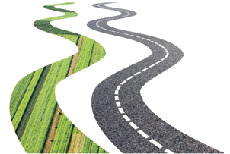
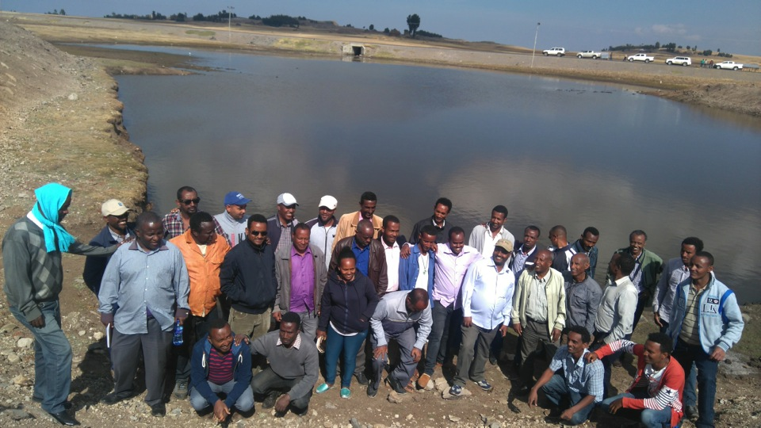
Join the Movement

Slide 37
Supported by:

