Slide 1
Issues and challenges in local road network development
and
integration of water management
workshop/training on Green Roads for Water
Kathmandu
Presented By
Maheswor Ghimire
Senior Divisional Engineer
Department of Local Infrastructure (DoLI)

Slide 2
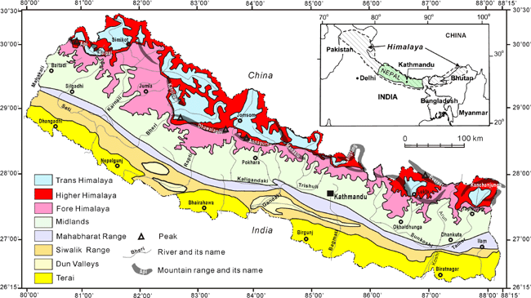

Slide 3
Road development and Geography
Nepal’s geography poses a significant barrier for the country’s aim to improve transport. The Himalayan range lies in the north of the country, including 8 of the world’s 10 highest mountains, and these present huge physical obstacles.

Slide 4
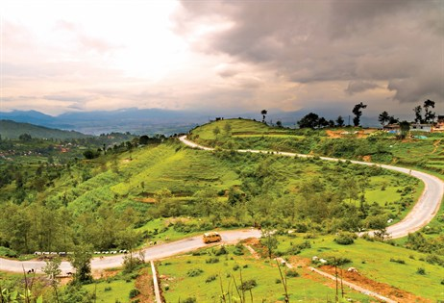
Contd..
In the southern lowland plains of the country, rivers descending from the mountains change course frequently, presenting another challenge.
Meanwhile Nepal’s Hill
Region includes altitudes
ranging from 800-4000 m
itself providing difficulties
for road builders.

Slide 5
Contd..
As a result of the technical issues resulting from the country’s geography as well as a shortage of construction machinery, building roads between cities, towns and villages in Nepal can be an
expensive
and almost painfully slow process

Slide 6
Weather and Roads
Water flow rates can be enormous due to run-off from mountain glaciers, becoming worse still during the monsoon season due to intense bursts of heavy rainfall.
80% rainfall within 4 months (average 1600mm)
Varies by eco-climatic zones(Pokhara3345mm,Mustang 300mm)
More than 6000 watercoarses
Of the existing roads (surfaced and unsurfaced), up to 60% become unusable during the monsoon season and that includes most of the rural road connections.

Slide 7
Nepal Road Networks (2 AH,4EWH,8NSCH)

Slide 8
Asian Highways in Nepal

Slide 9
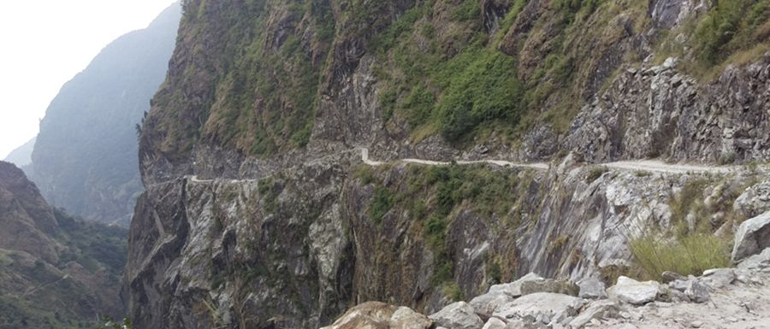
Classification of Nepal Roads
Strategic road network (SRN)
Local road network (LRN)

Slide 10
Road Density
Road building started to gain momentum in Nepal with the advent of multiparty democracy in the early 1990s, intensified further after the Maoist insurgency ended in 2006 and continues to be one of the country’s main priorities
13.7 km per 100 km2 in 1998 (Lowest in the world)
By 2016, it had increased to 49.6 km per 100 km2 and continues to increase at a very rapid pace
Increase in LRN 1200%

Slide 11
Issues in Nepal Roads
Nepal’s roads are in a treacherous state, subject to frequent rock fall, landslides and accidents
main causes of road accidents is road design, including very steep gradients, lack of safety features and poor road conditions.
Local road construction or so-called “dozer roads” are most often initiated and constructed by bulldozer owners in collaboration with politicians without basic gradients and drainage

Slide 12
Contd..
Dozer roads are usually constructed or upgraded during the dry season
During the monsoon, road segments are frequently washed out because a majority of these roads lack proper engineering (WB-GON, 2013).
Road failures are cleared up at high cost after the monsoon and the failure-and-clearance process is repeated for years until there is no loose soil to block roads (Leibundgut et al., 2016).

Slide 13
Contd..
Such rapid and ineffective road construction throughout the country, but particularly in the middle hill and mountain areas, is placing increasing pressure on fragile ecosystems, wasting government resources, and increasing risk to road passengers and roadside dwellers (DOR, 2013a; Singh, 2018).

Slide 14
Contd..
Roads in Nepal at a new crossroads greatest anthropogenic drivers of environmental degradation, erosion and landslides in Nepal
This situation is worsening due to the intensifying rainfall during the monsoon, largely attributed to climate change (Petley et al., 2007; Bharti et al)
possibility of an earthquake of even greater magnitude than the 2015 Gorkha earthquake.

Slide 15
City Road after Gorkha Earthquake

Slide 16
Roads Legisliative
Plans 20 years Masterpaln, DTMP, MTMP,PTMP
Acts Public roads acts 2031
Policy 2hours walking distance to get public vehicles
Standrads NRS2070, NRRS2071
New Responsibilities R/MCs, DoLI, DoR, Province govt

Slide 17
Real Scenario
Local governments are not following
require proper road engineering practices, various levels of environmental assessments and approval
greater emphasis on regular maintenance of roads,

Slide 18
Cut Slopes

Slide 19
As results in built roads
Category | Potential Problem | Appropriate environmental mitigation measures
Slope stability | -landslides or other forms of mass instability on the slopes -development of erosion or gullying. | -Avoid such sites at the time of alignment selection -Use of simple retaining structures and bio-engineering -Minimize earthwork in rainy season -Measures to avoid undercutting of slope toes -No quarrying in river beds, where increased flood discharge velocity could give rise to subsequent damage -Provide slope protection measures.i.e. check dams and bio-engineering works as necessary
Spoil disposal | -spoil tipped away from designated areas -spoil falling or being wasted on to farmlands | -Minimize spoil by cut and fill operations wherever required -Identify safe tipping and enforce best practice like compaction, grading and provide drainage -Construct spoils traps, provide drainage or compensate land owner.
Water management | -scour and erosion below unprotected drainage outfalls | -Check dams and other measures as necessary, constructing cascades, as long as necessary

Slide 20
Contd…………..
Forests, plants and wildlife | -loss of forest land -large numbers of trees being removed - wildlife disturbance | -Avoid forest areas while selecting route -Strengthen and support Community Forest User Groups (CFUGs) -Afforestation in nearby degraded area/protect the affected forest -Replant wherever trees have been cut down and wherever land is available, using the same species as possible and -Avoid damage to wildlife habitats, habitats recreated on marginal roadside land and prohibit hunting
Quarries and borrow pits | - pollution and disturbance from quarry operations - safety risks from borrow pits and abandoned quarries - land seriously disturbed or lost from production | -Site away from settlements -Quarries made safe by re-grading slopes and installing -structures as necessary -Quarry and burrow areas rehabilitated to productive plantations using bioengineering techniques.
Community Infrastructures | - disruption to irrigation canal, water, supply lines, trail and bridges | -Measures to resolve these problems incorporated into project works -Inventory of affected infrastructures -Relocate affected infrastructure facilities and compensate for relocation cost

Slide 21
Contd…………..
Dust and noise | -dust generated from construction works or by traffic. -dust from earthen road | -Speed controlled by speed bumps. If water is available, the road surface can be sprayed on a frequent schedule -Permanent speed bumps installed in villages and bazaars to reduce traffic speeds in inhabited areas. -Bitumen surface constructed in bazaars with speed controls -Planting roadside vegetation
Social and cultural issues | -degradation or loss of local worship sites, or graveyard/ burial ground -loss or degradation of private houses and agricultural land -project work excluding local people | -Avoid during centre line fixing, -Facilitate local consultation for a justifiable and agreeable negotiation, pay compensation -Designs incorporate methods within the skills of local people -Use local labor wherever possible, training to local people
 | -pollution from work and labor camps -cutting trees for fire hood -damaged land after construction | -Check that camps are not polluting neighbors from sewerage and rubbish disposal -Kerosene stoves and kerosene provided to labors -checks to ensure camp areas are fully restored, including re-top soiling and planting where necessary.

Slide 22
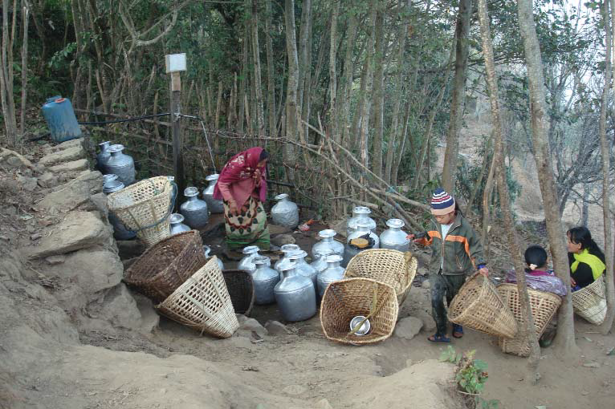
Draught

Slide 23
Why are Result & Impact Indicators Needed?
To better understand the positive/negative results of road.
The main questions are:
What change is needed?
For whom?
How to measure this change?

Slide 24
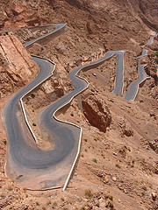
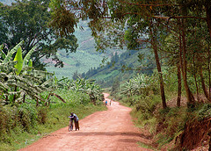
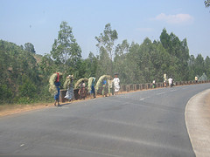
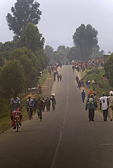
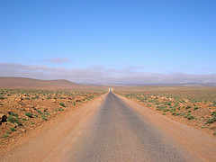
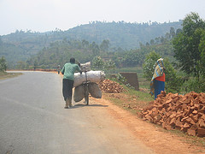
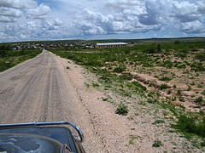
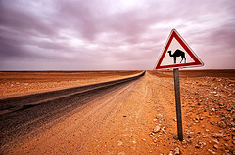
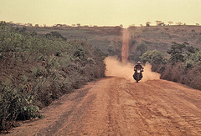
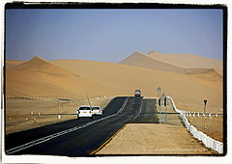
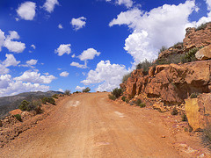
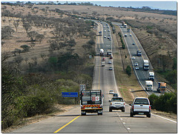
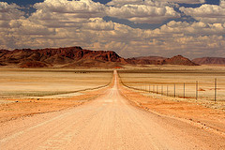
Common Indicator of Success
Kilometres of Roads…

Slide 25
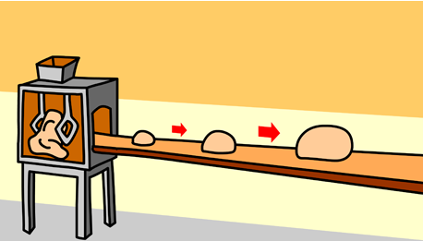
Examples - Real Indicators of Success
Education
Trade
Other Factors
Kilometres of Road
Time
Health
Jobs/Profits
Cost
Environment
Poverty
Reduction

Slide 26
Intervention Logic
Output
Clusters
Results
(Outcomes)
Specific
Impacts
Intermediate
Impacts
Global
Impacts
Lower Road Transport Time
Greater Economic Accessibility
Improved Conditions for Economic Growth
Infrastructure
(construction/ maintenance)
Lower Road Transport Costs
Greater Accessibility to Social Services
Economic Growth
Improved Institutional Management of Road System
Institutional Reform
Poverty Reduction
SDG
Economic
Increased Employment
Social Development
Environmental Impacts of Roads Minimised
Environment
SDG
Enhanced Human Capacity
Social
Enhanced Safety & Health Linked to Roads
SDG

Slide 27
ISSUES OF TRANSPORT AND ECONOMIC DEVELOPMENT
Transport is the ‘Infrastructure’ of Infrastructures
Transport Investment 4%-8% of GDP in most of the countries (Mody, World Bank, 1997).
Strategic Road Network (SRN) 1.2% of GDP in 2007/8 increased to 2.3% in 2011/12(GON, 2013).
Transport and Macroeconomic Impact
Development of Low-carbon Transport System.

Slide 28
Integration of water mgmt in road
Design (Peak)discharge Calculation
Less precipitation measurement stations.
Few flood mesurements gauge in streams and rivers.
Chezy’s formulla Q = C i A
i = rainfall intensity (in/hr)
for a critical time period, tc
A = drainage area (acres).
The runoff coefficient, C

Slide 29
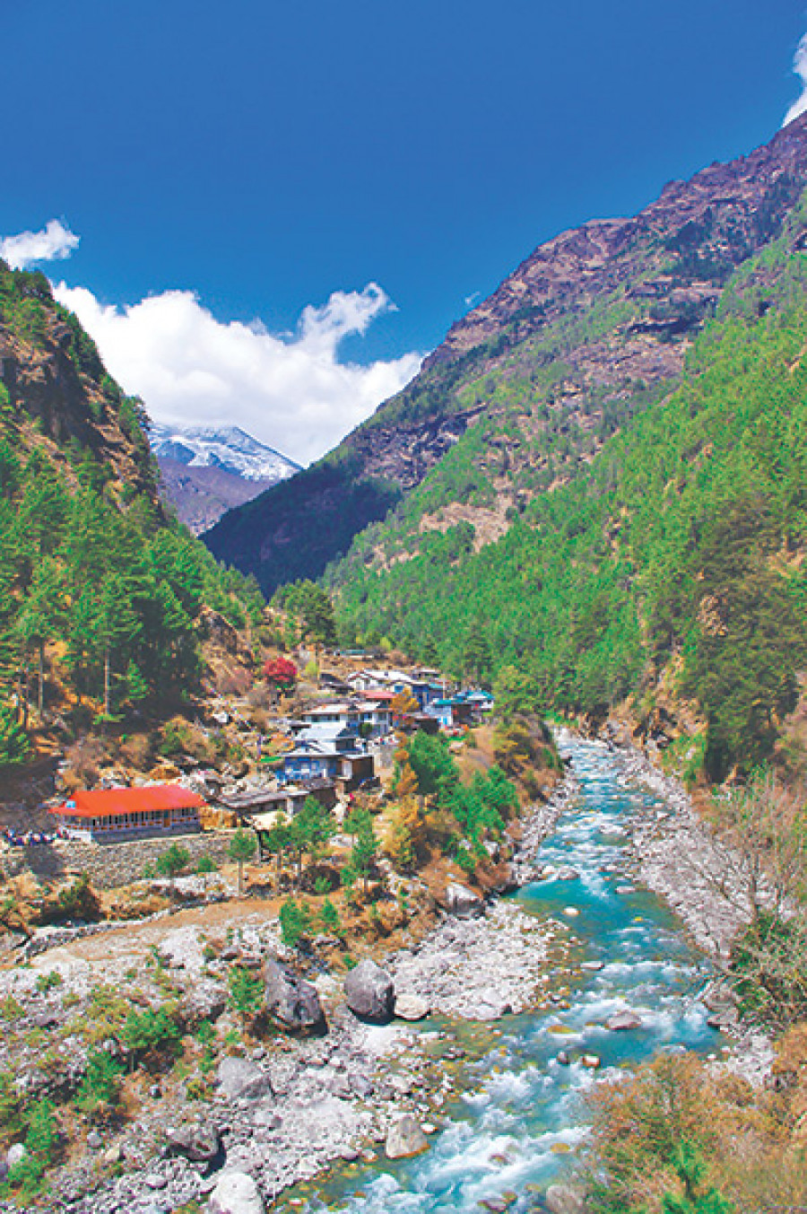
Contd..
Manning's formula
Q = n-1 A R2/3 S1/2
where:
Q = discharge (m3/s)
A = cross sectional area of the stream (m²)
R = hydraulic radius (m),
(area/wetted perimeter of the channel)
S = slope of the water surface
n = roughness coefficient of the channel.

Slide 30
Design of roadside and Cross drainage Structures
Frequently used type designs
Ignored critical depths and freeboard
Sediment loads are overlooked (check dams, d/s protection structures)
Not considered min and max. velocities
Off road drainage facilities (French drains)
Improvements of natural drainages
Uses of drain out waters (agricultural fields, water mills)

Slide 31
Contd..
Types of camber
Minimum gradients
Shoulder materials
Smooth transition of carriageway drainage from shoulders to side drain
Formation levels of roads in inundation areas
Choice of pavements materials

Slide 32
Construction
Design slope
Workmanship
Hairpin bends
Cascades principles in series of loops
Long ways to carry discharges

Slide 33
“Dewatering” elements
:
– Cross fall
– Road shoulders
– Impermeable road surface materials
A typical “drainage” system consists
– Outlet ditches
– Side ditches
– Culverts
– Inner/outer slopes
– Road structures
– Underdrains

Slide 34
Operations and maintenance
Length Workers
Road Maintenance Groups (RMG)
Performance based contracts
Routine, Recurrent, periodic maintenance
Rehabilitation

Slide 35
Conclusion
There are possibilities of new economic opportunities, ultimately reducing economic vulnerability. However,Local roads, especially when poorly constructed, present particular challenges to sustainability, risk and governance Finally, the issue of poorly designed and risk-filled roads in Nepal is a political rather than technical issue. As Nepal moves towards greater constitutionlization of Federialism power, there is considerable opportunity for its local, province and national administrations to turn the tide toward safer and more sustainable road development.

Slide 36
Let’s not drive in the rain!

Slide 37
Driving vehicles on wet road surface can easily damage the road!
The furrows made by motor tyres should immediately be filled up.

Slide 38
A landslide on the road surface that needs to be immediately cleared.
Things to Remember
The small landslides remaining after clearing a landslide act as a preventive measure against other landslides.

Slide 39
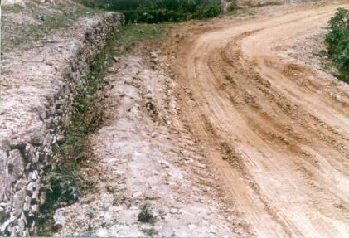
Damaged shoulders that call for recurrent repair and maintenance

Slide 40
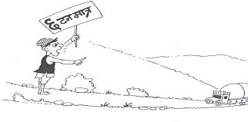
Only up to 6 tonnes

Slide 41
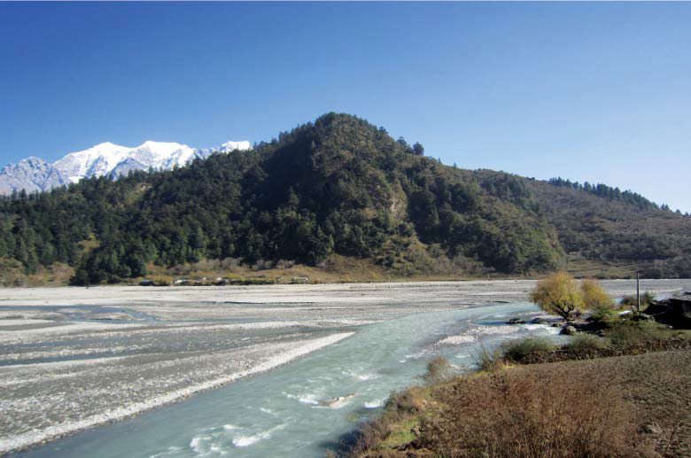
River Basin

Slide 42
Thanks
Any Quarries

